Slide 1
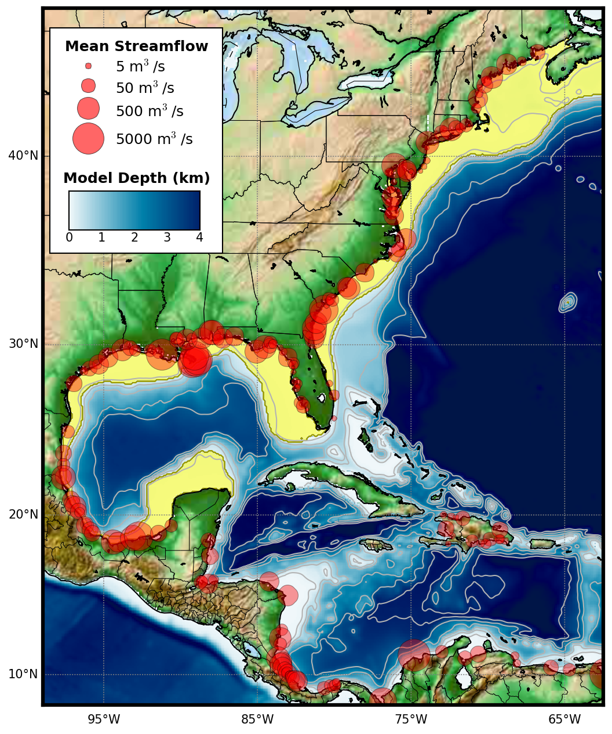
Figure 1: US East Coast ROMS domain with model bathymetry shown in blue. Gray contours indicate the 100, 500, 1000, 2000, 3000, and 4000 m isobaths. Red circles indicate the location of each river point source, where the size of the circle represents the magnitude of the mean annual streamflow. The yellow shaded region indicates the shelf residence time domains for the Gulf of Mexico and the US East Coast.

Slide 2
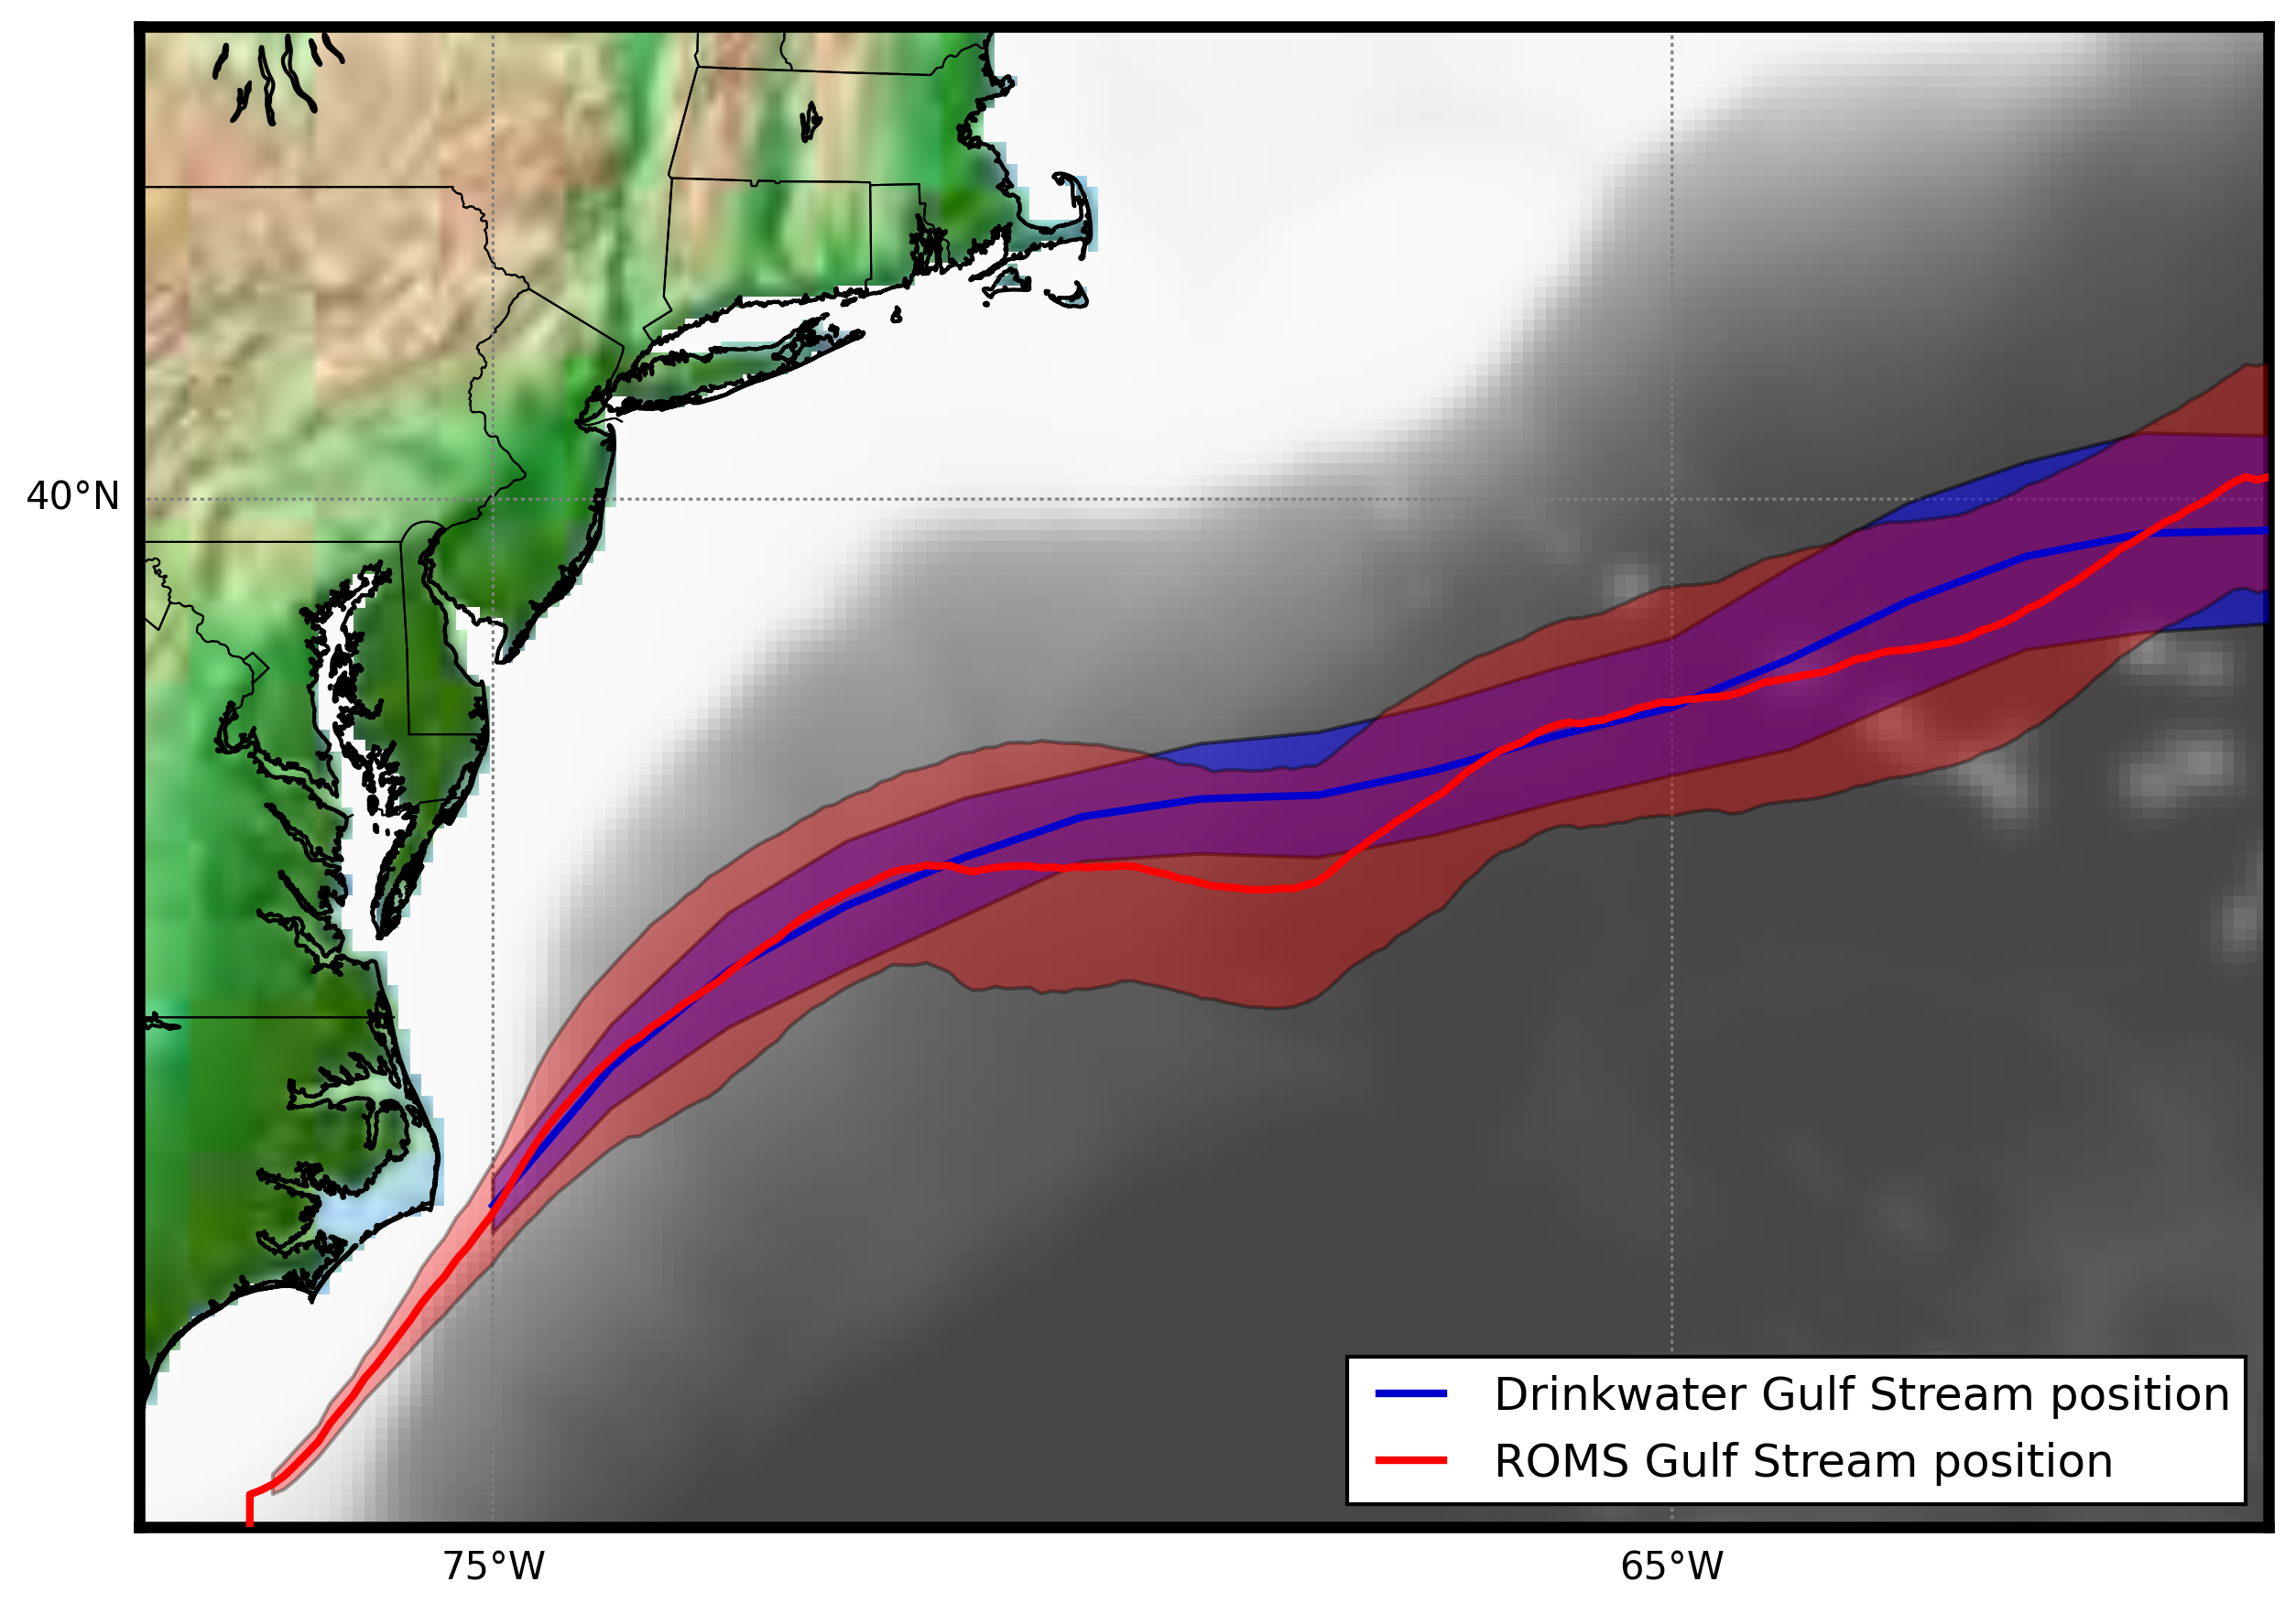
Figure 2: The mean location of the Gulf Stream Front estimated from ROMS simulations (red) and from historical observations from Drinkwater et al. (1994) (blue). The shading indicates the standard deviation whereas thick lines represent the mean position.

Slide 3
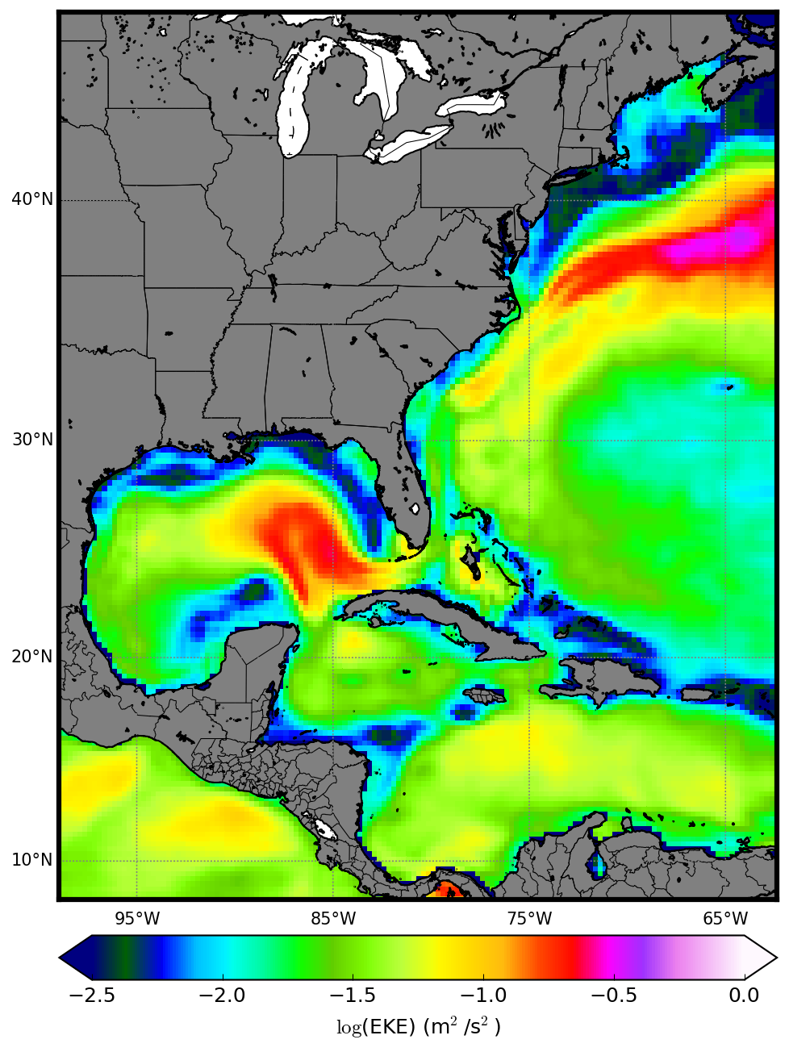
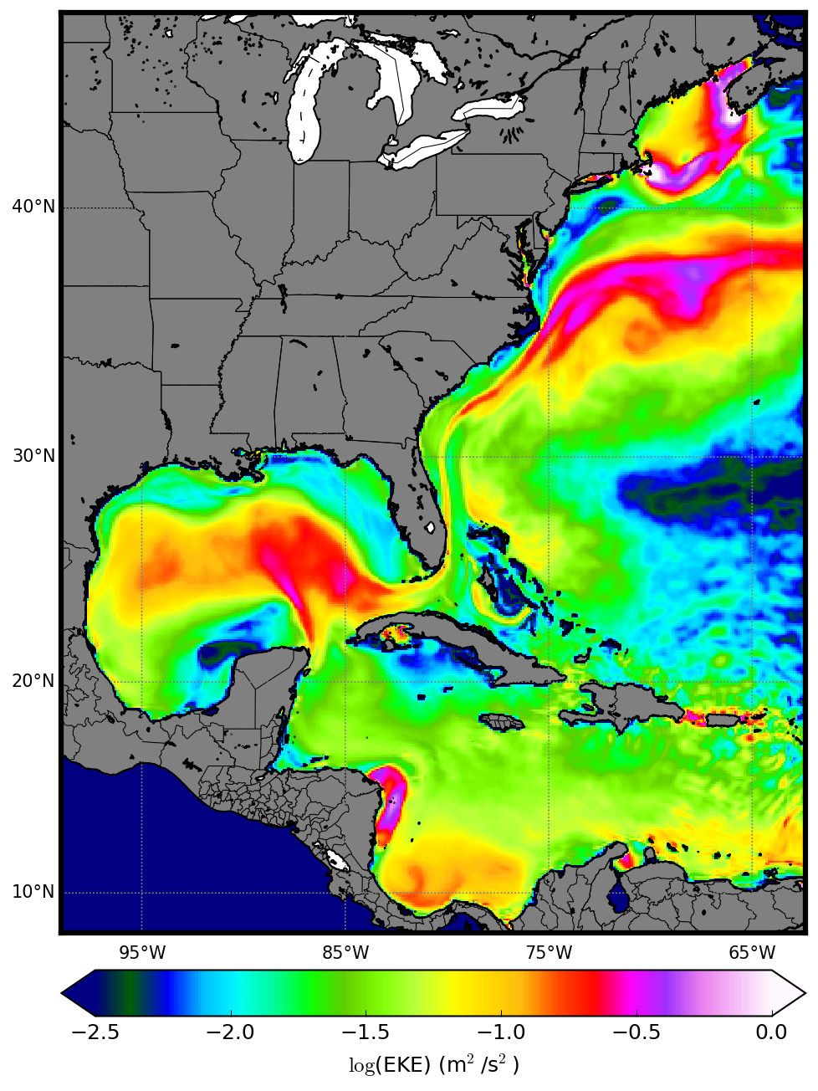
AVISO
Figure 3: Mean Eddy Kinetic Energy (EKE) estimated from sea level height anomalies. AVISO satellite EKE (left) are calculated from daily gridded fields, whereas the EKE from the ocean model simulations (right) are calculated from three-hourly fields over the six years after model spinup.
ROMS

Slide 4
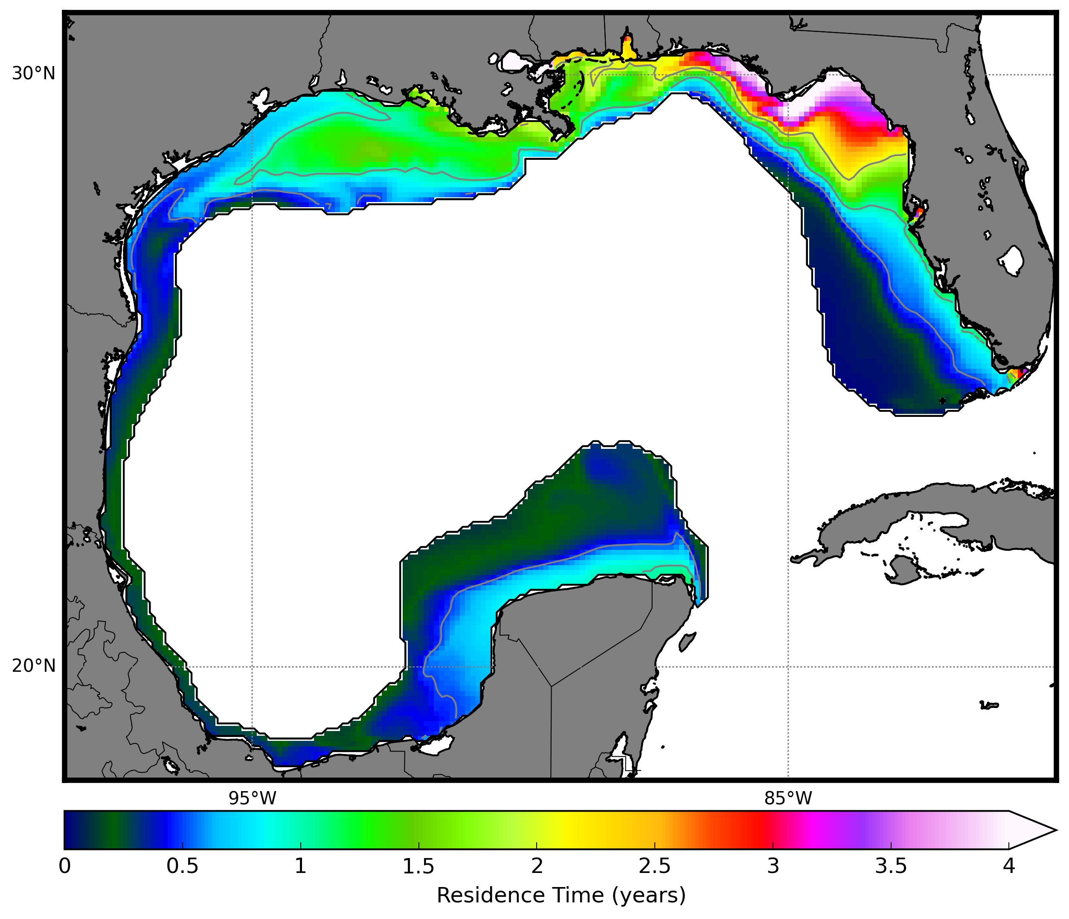
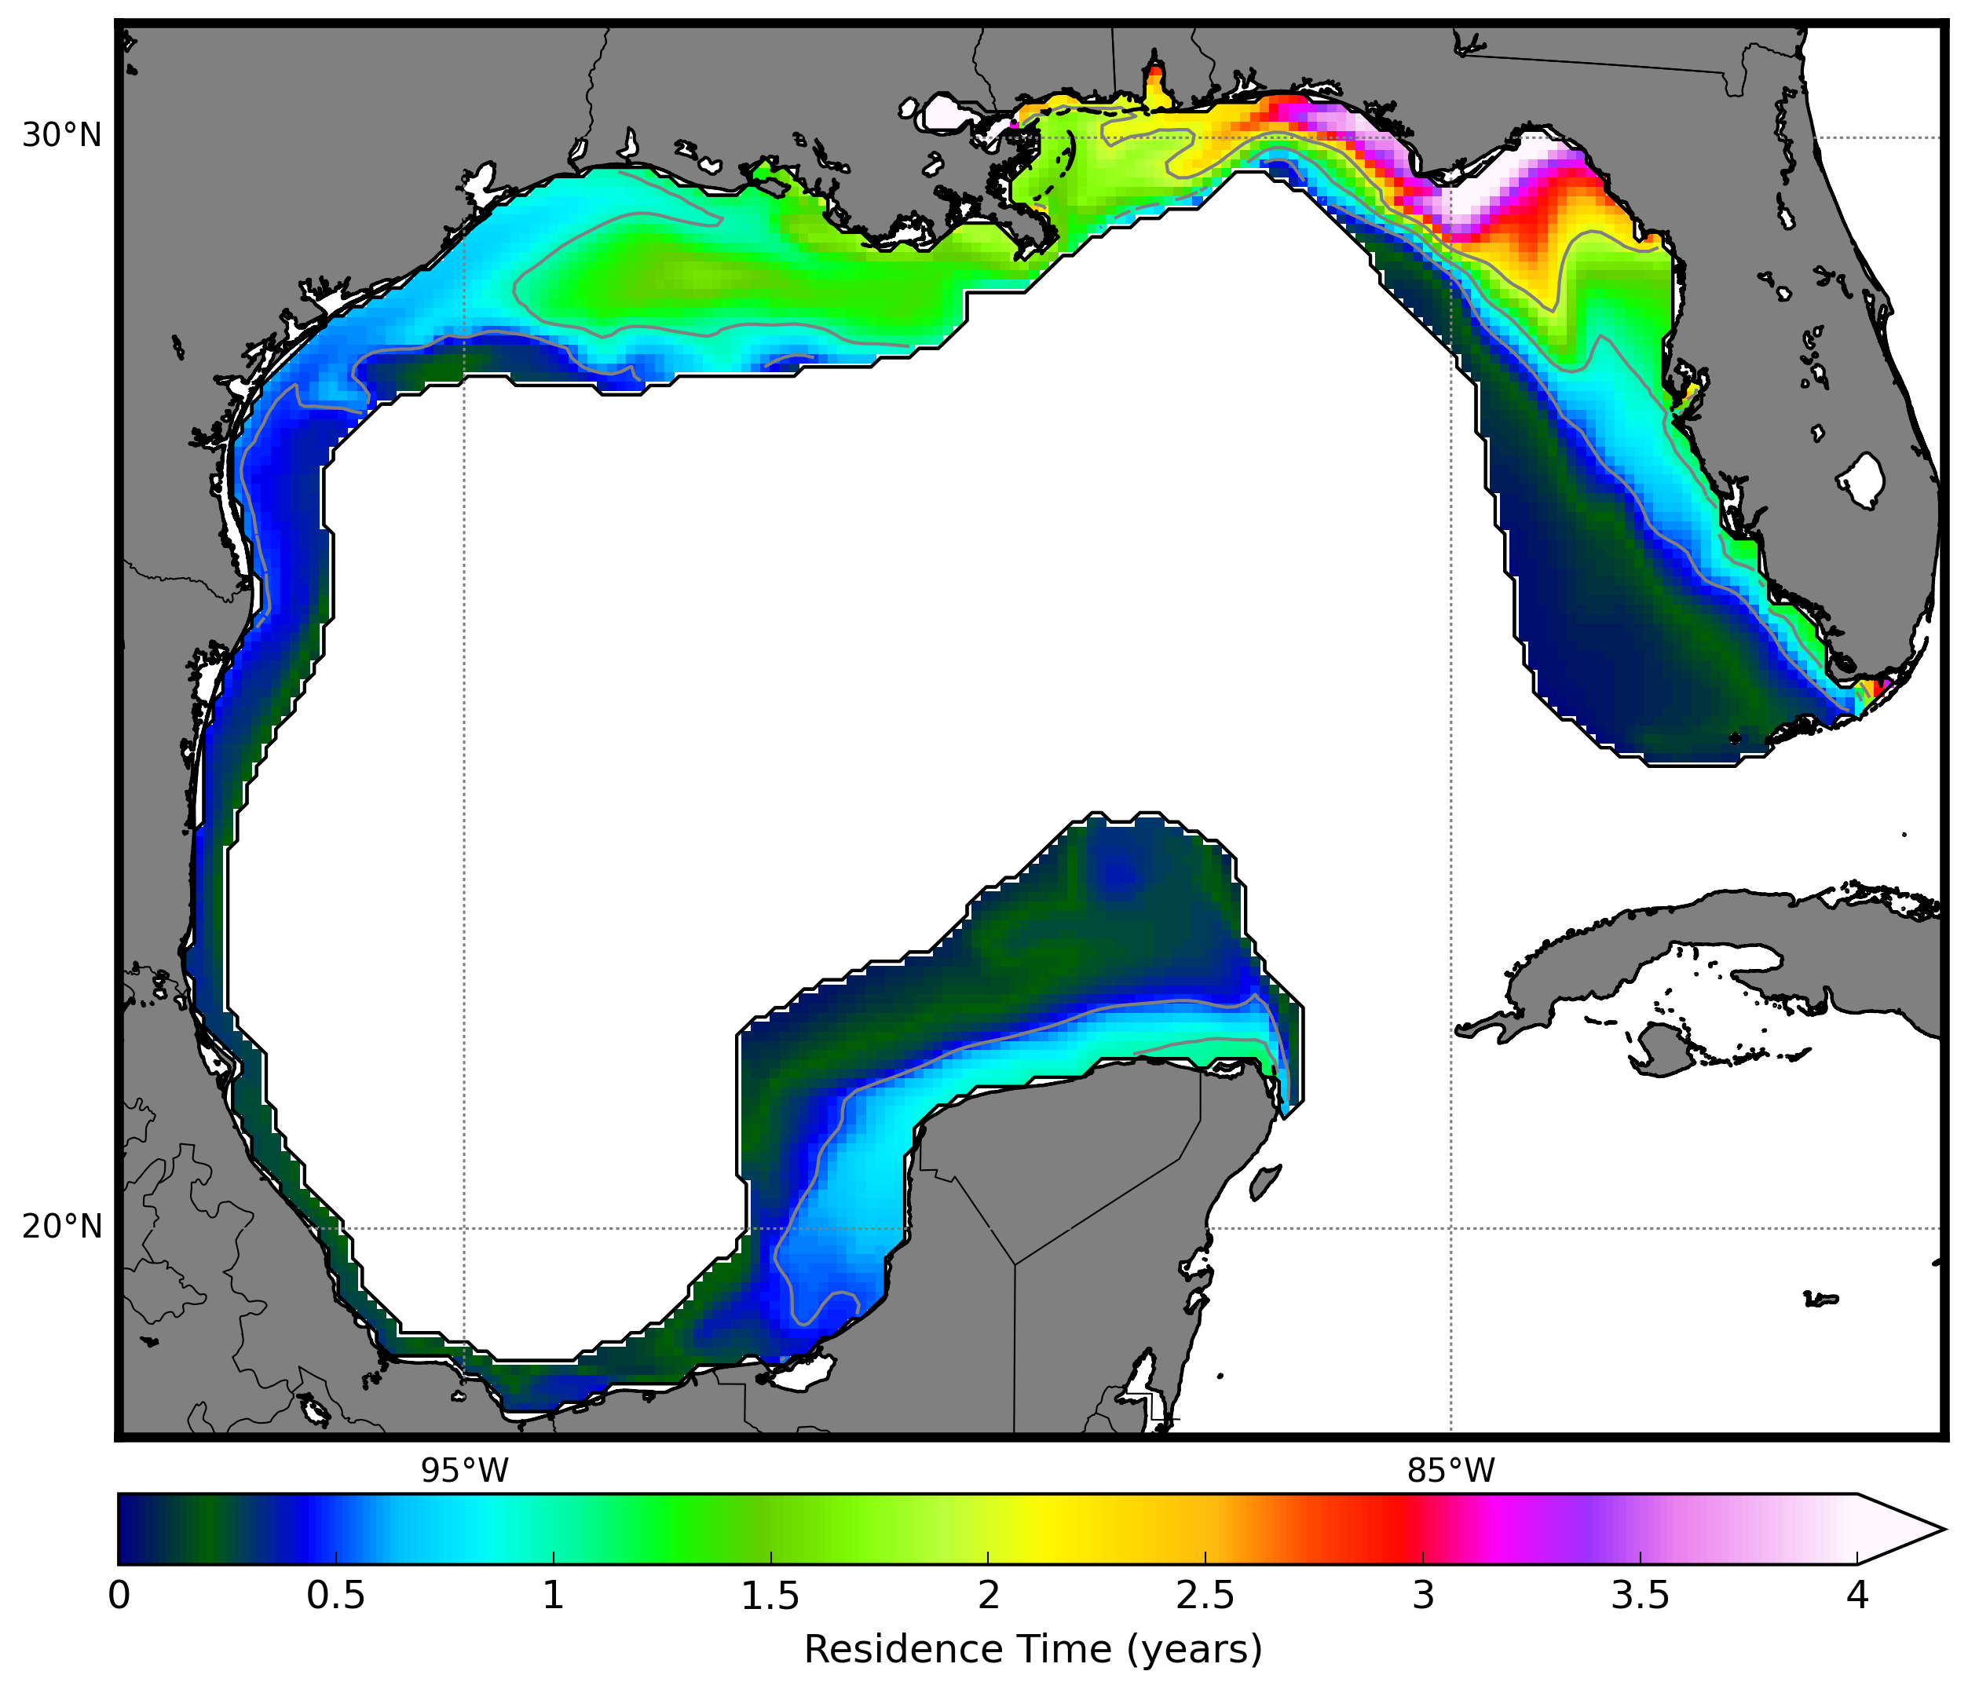
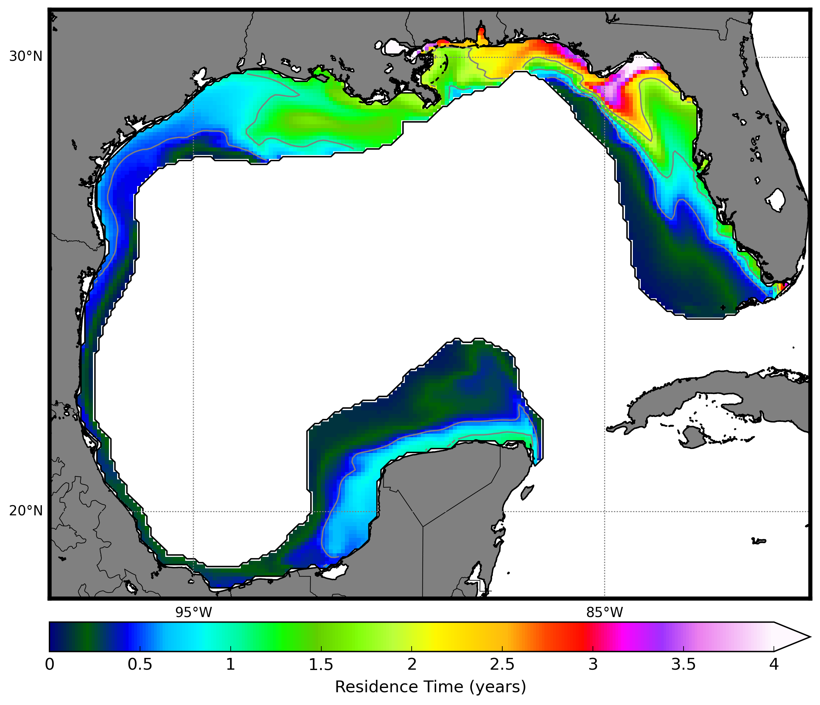
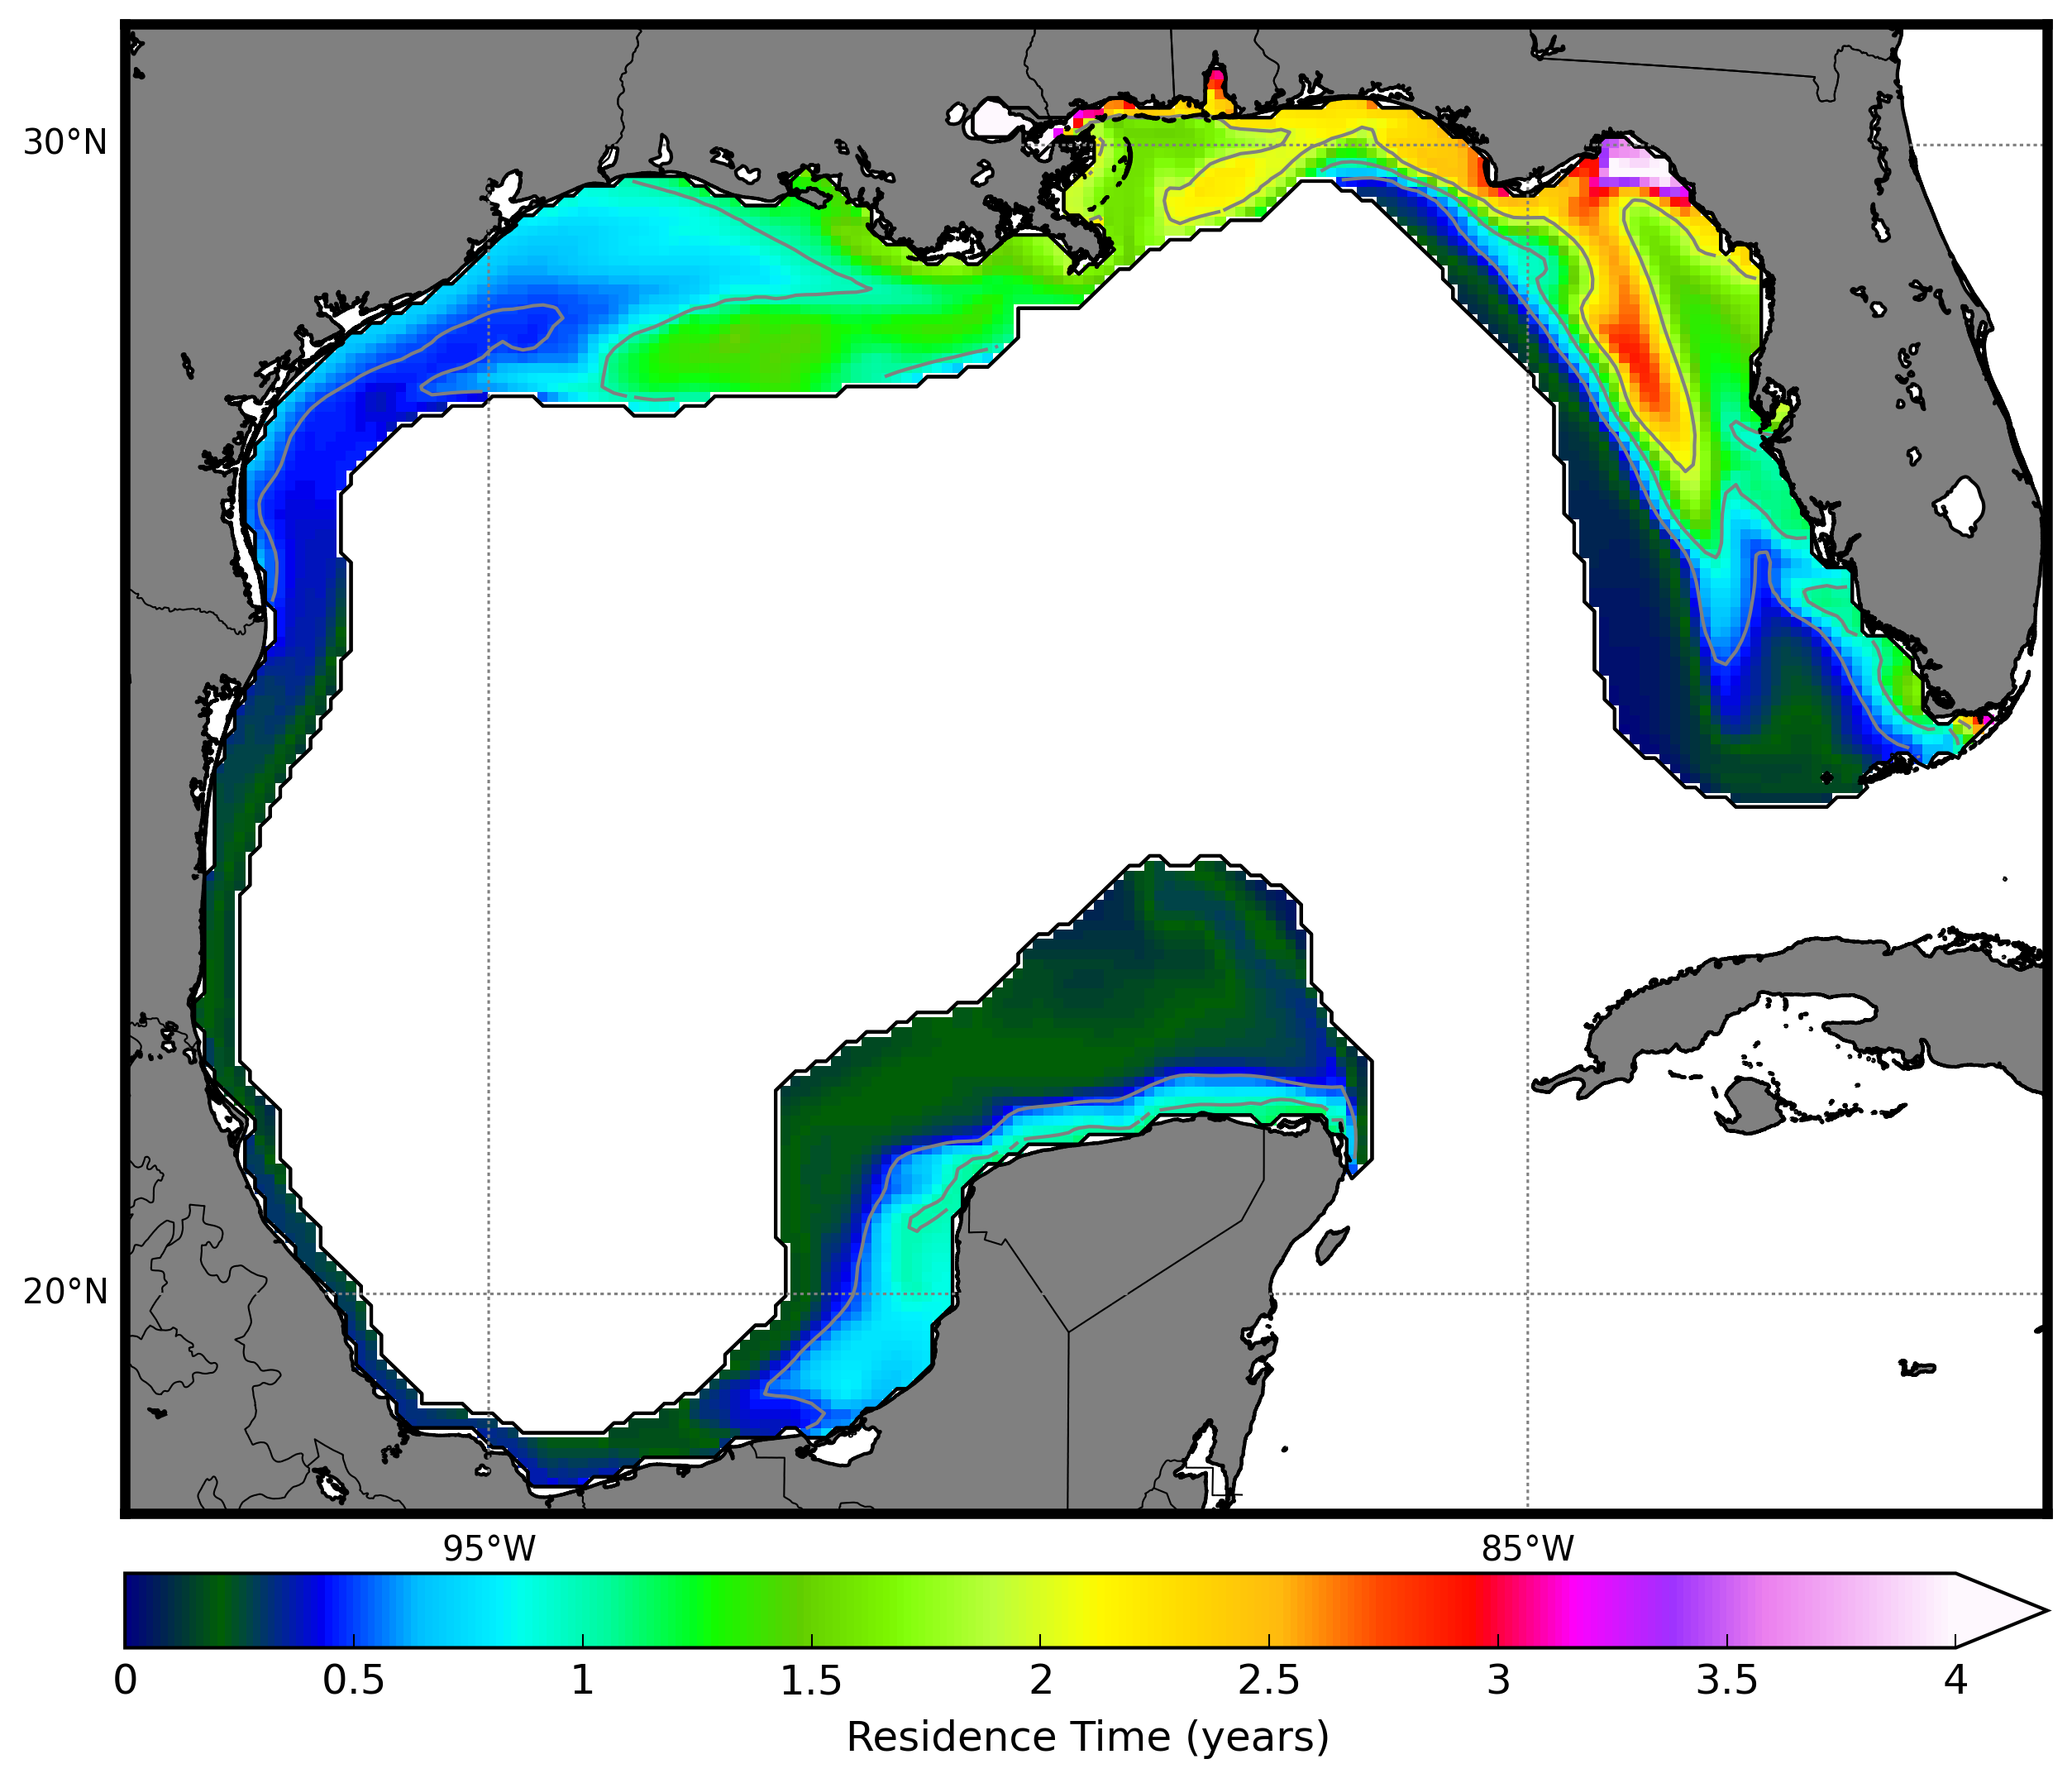
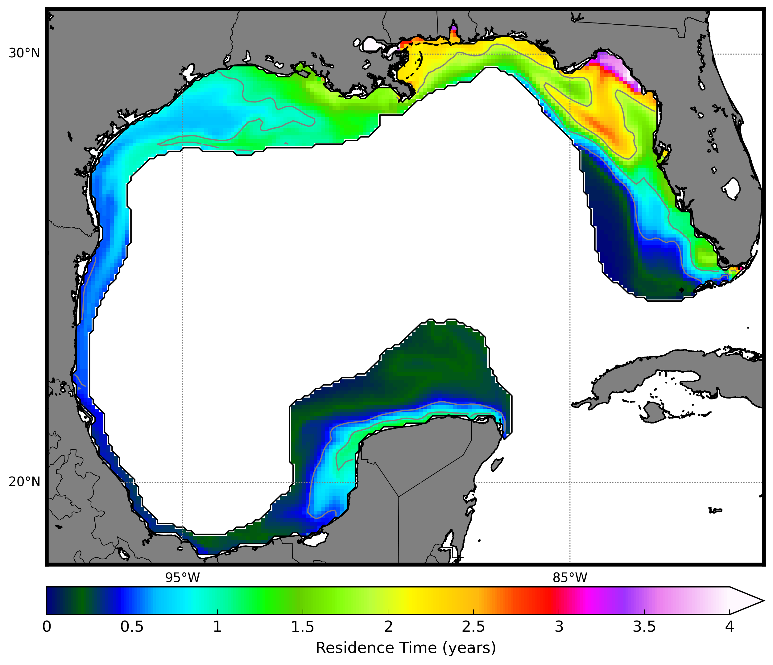
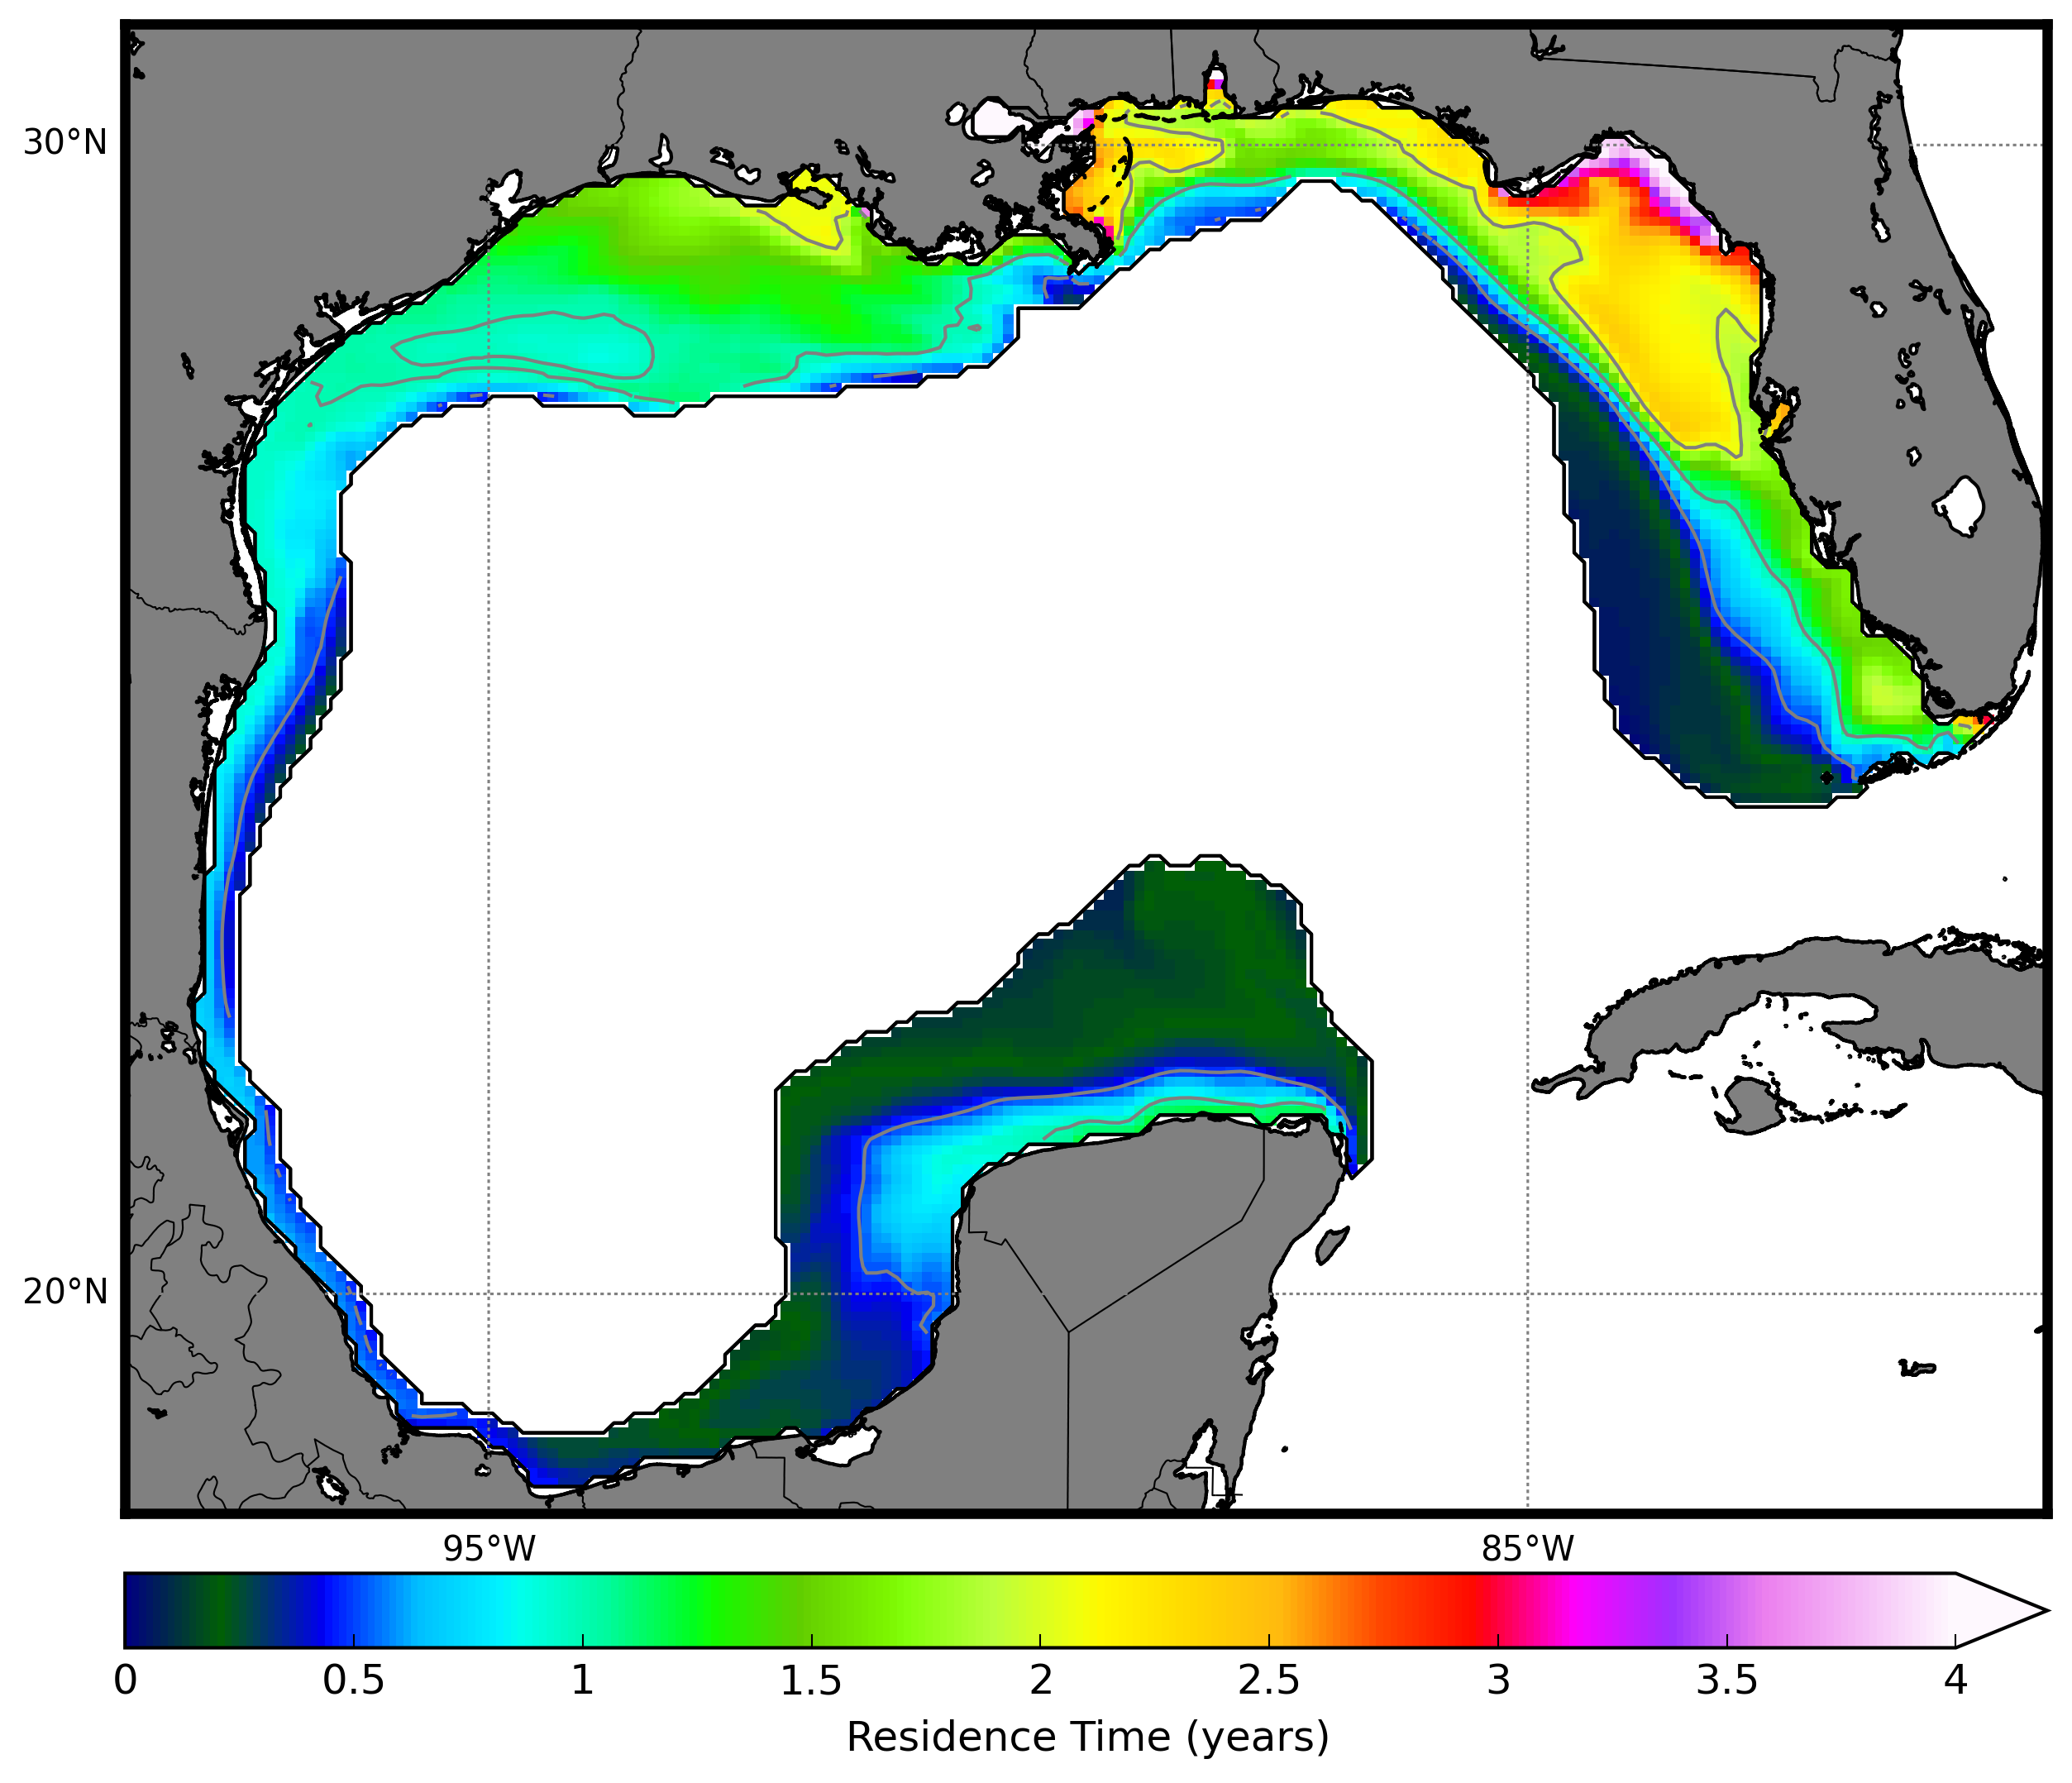
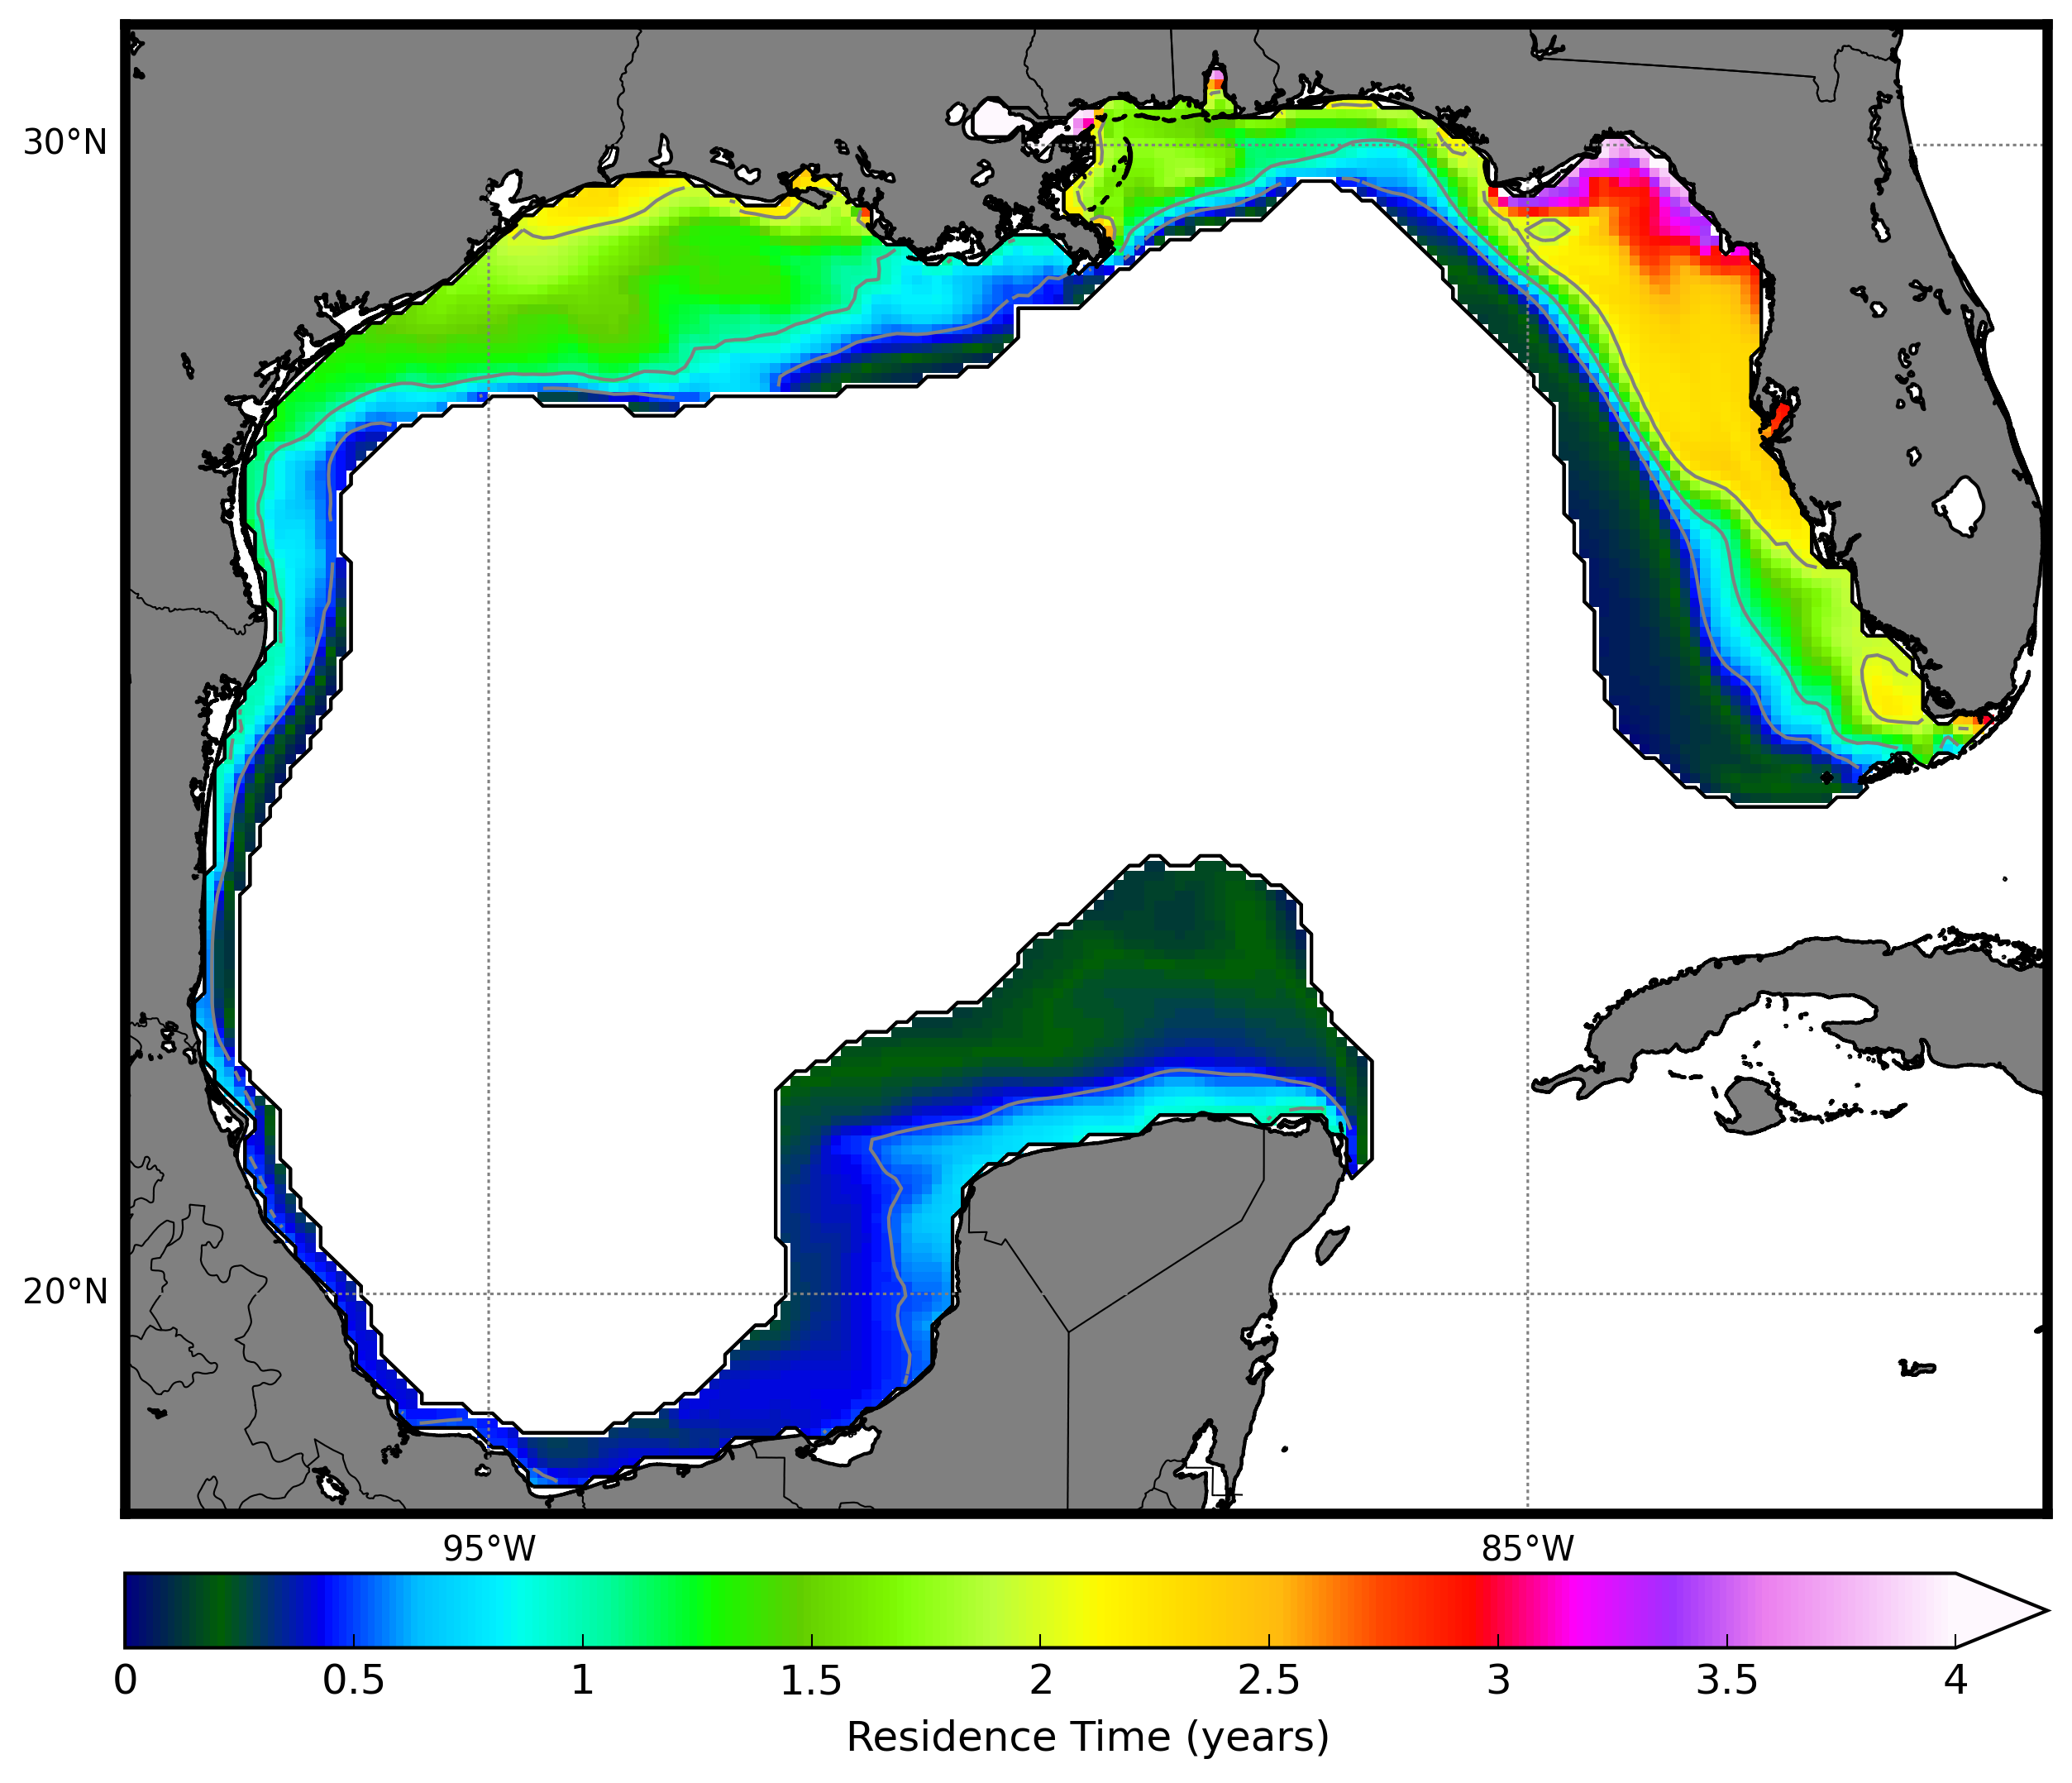
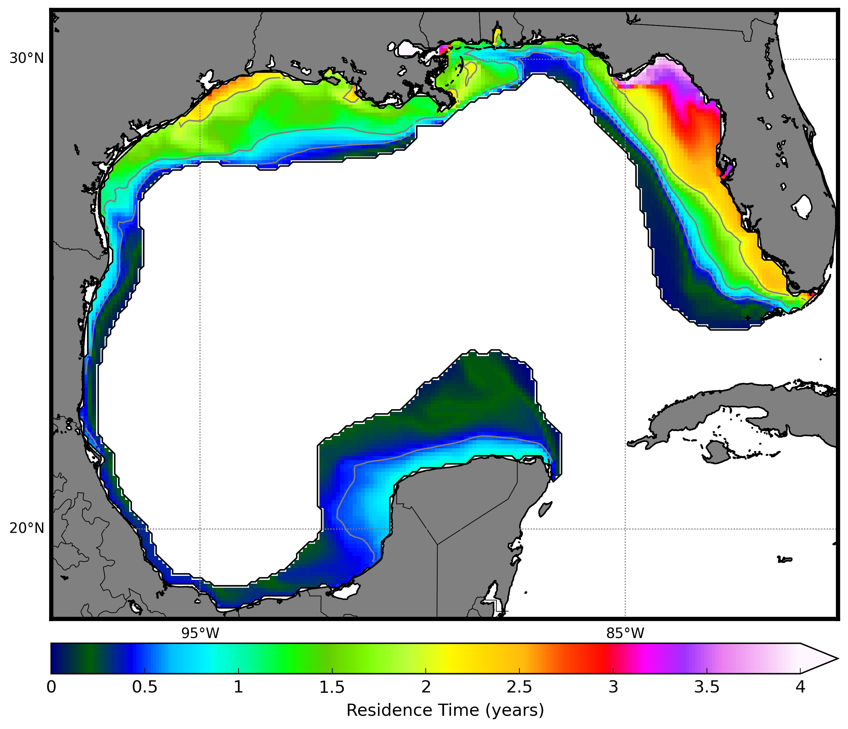
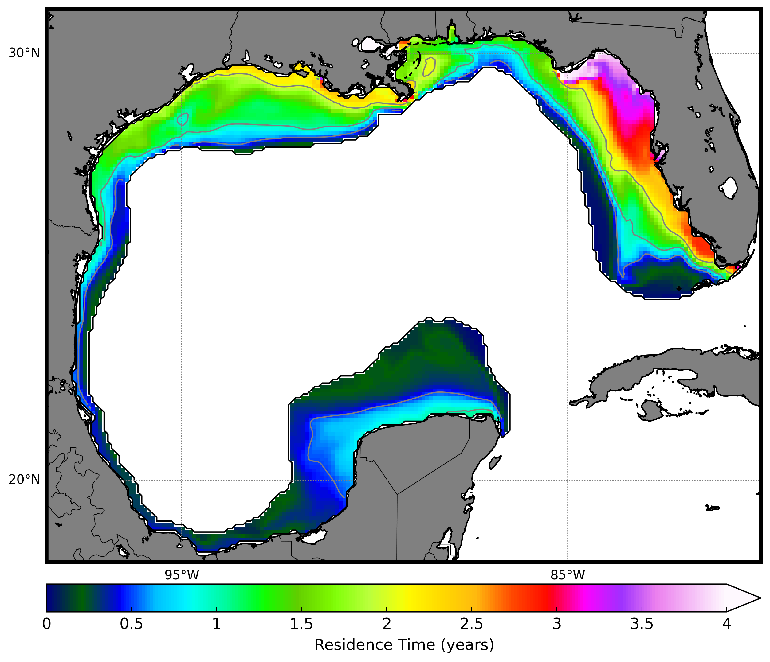
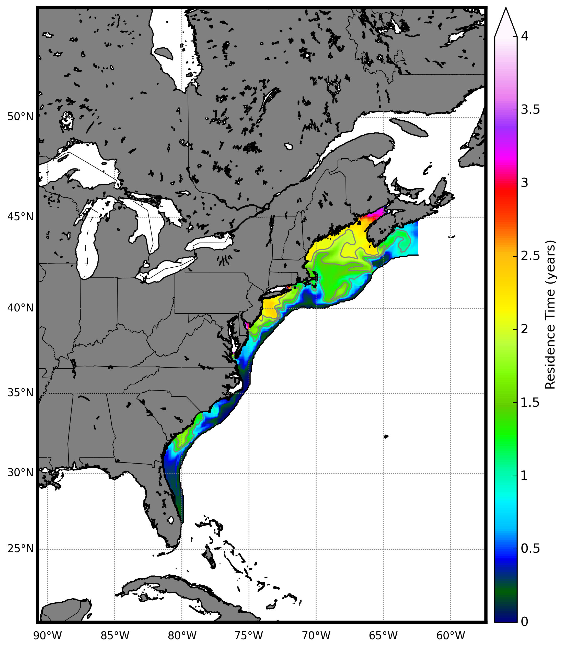
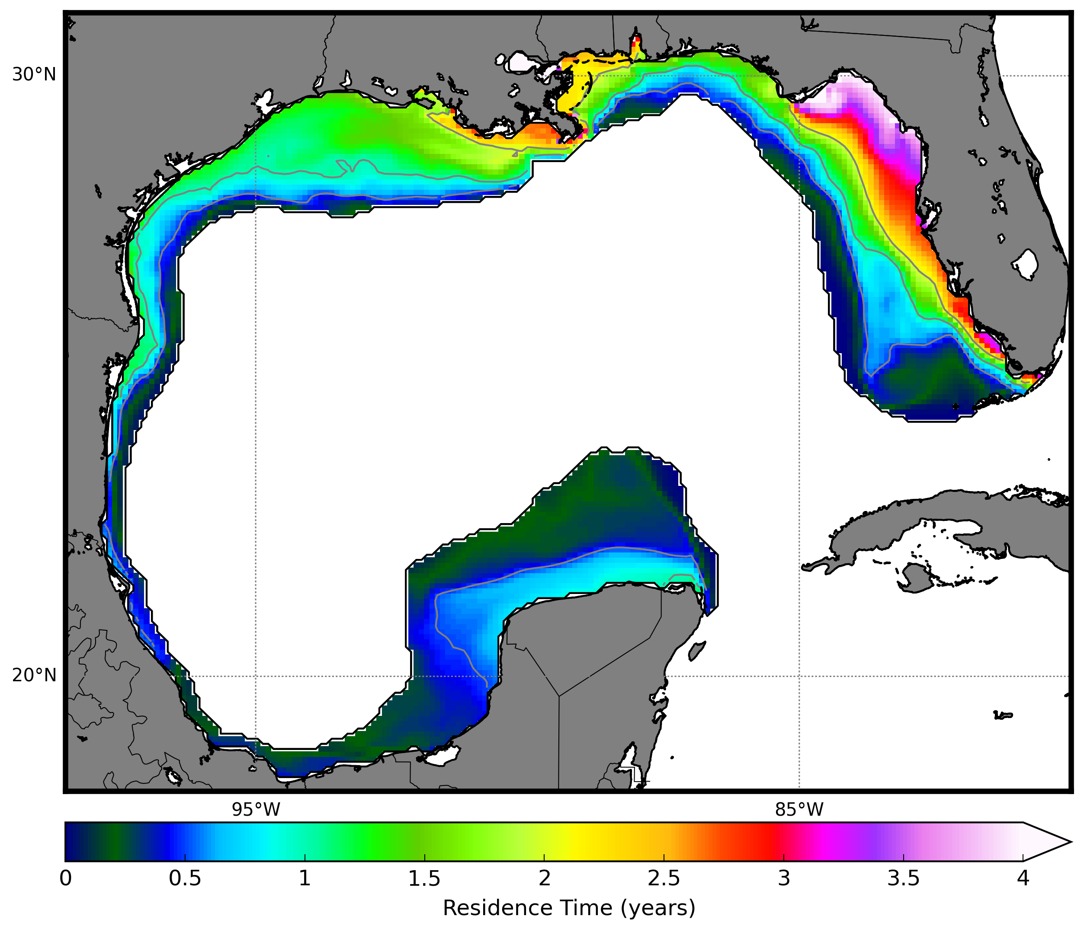
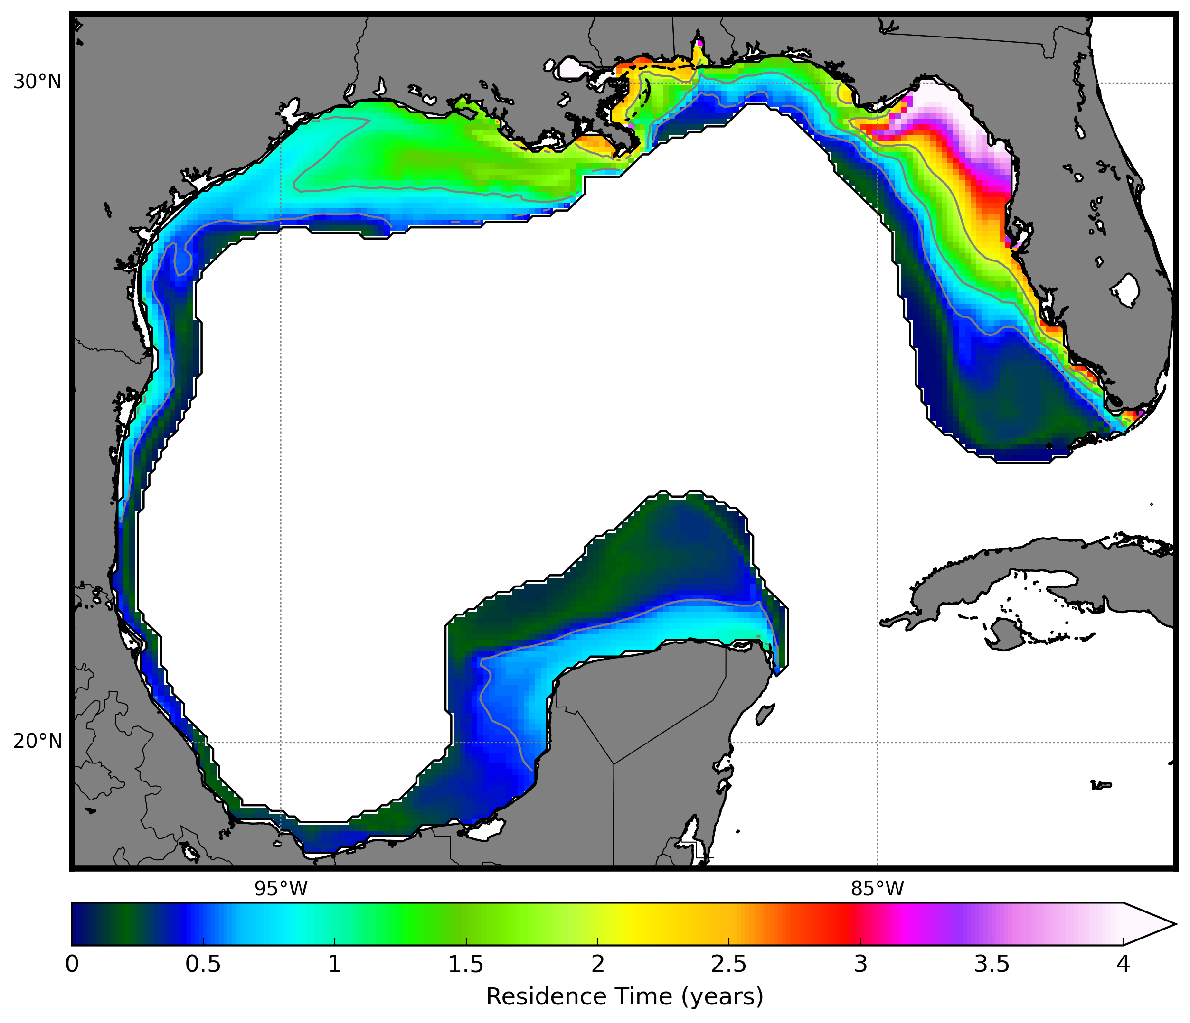
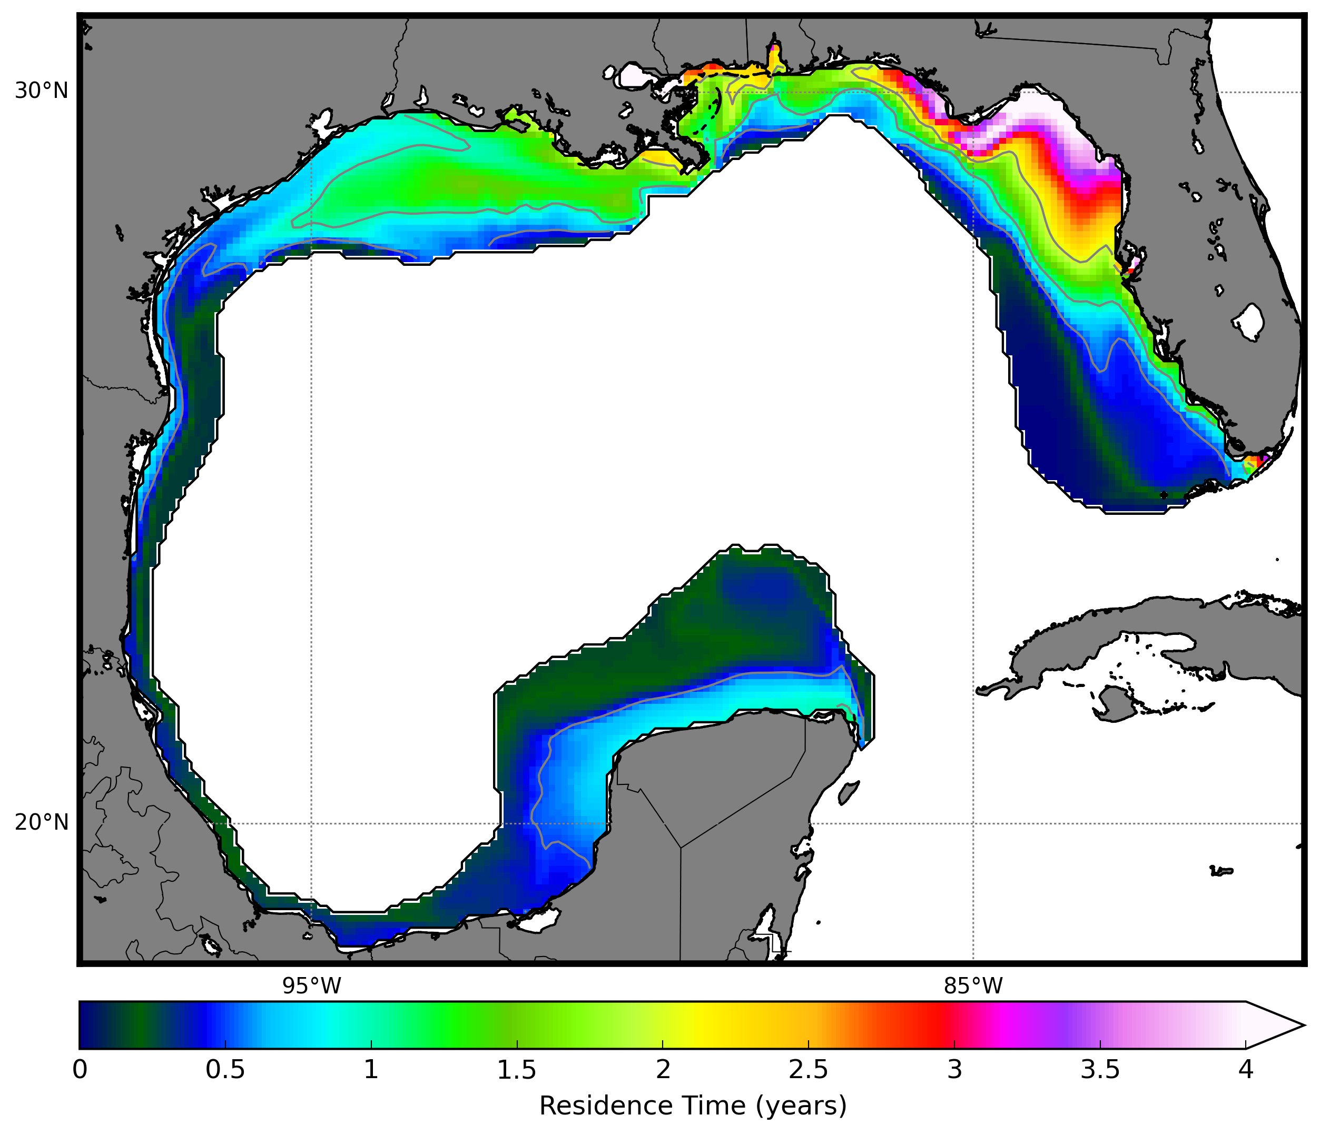
Jan
Feb
Mar
Apr
May
Jun
Jul
Aug
Sep
Oct
Nov
Dec
0
0.5
1
1.5
2
2.5
3
3.5
4
Surface Residence Time (years)
Figure 4: Monthly mean residence time of surface waters within the Gulf of Mexico shelf domain. Gray contours 1, 1.5, and 2 years.

Slide 5
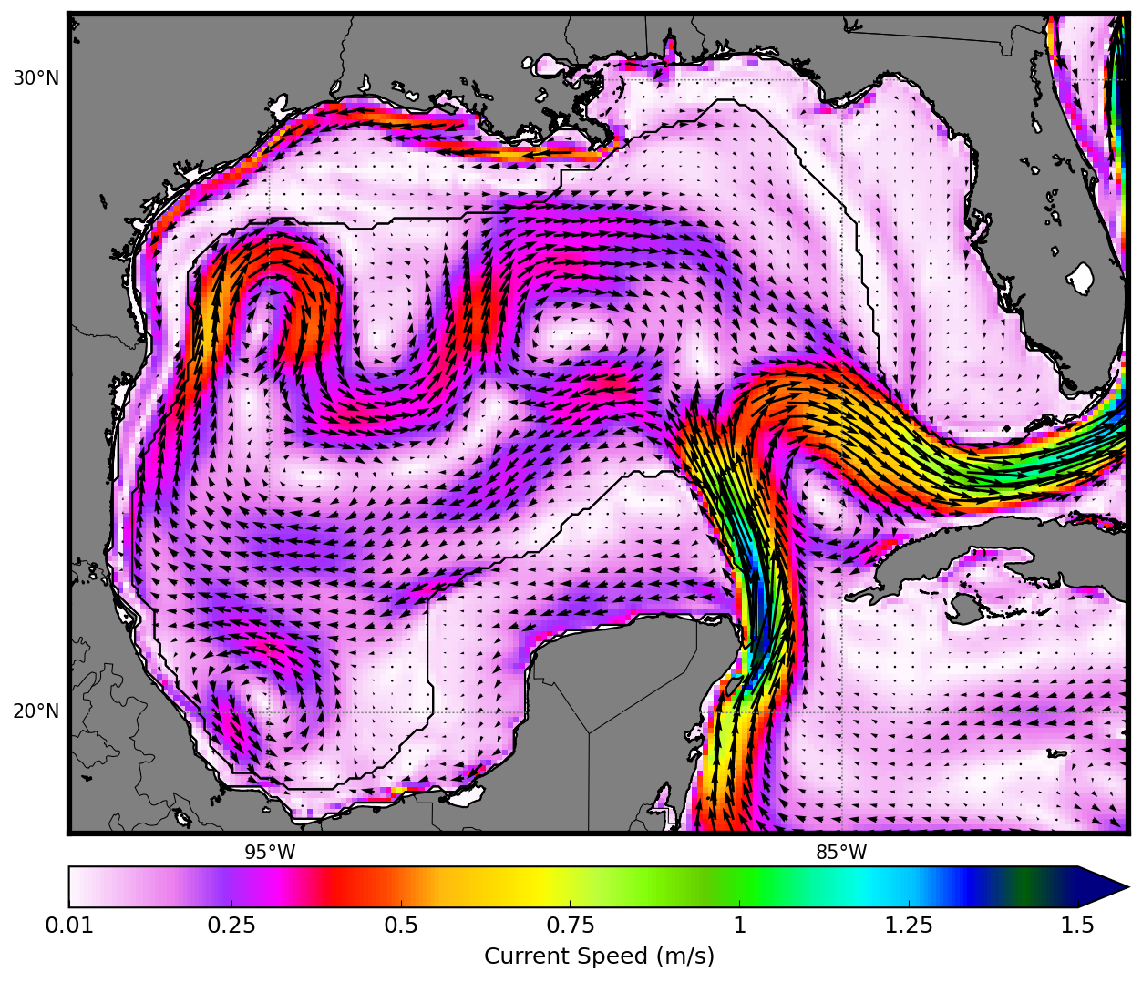
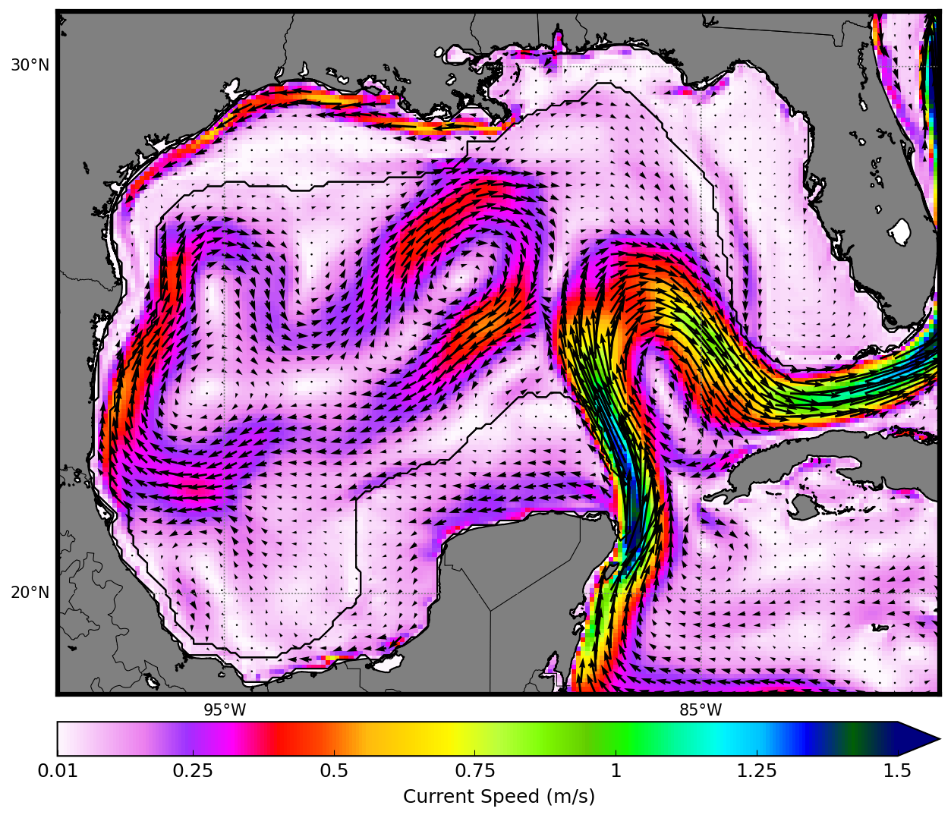
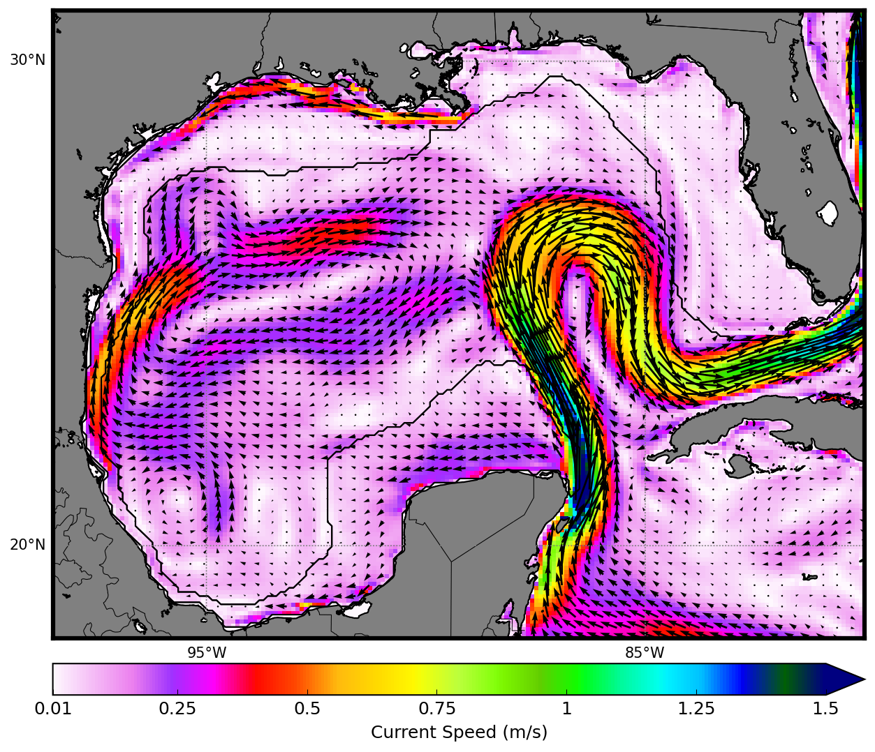
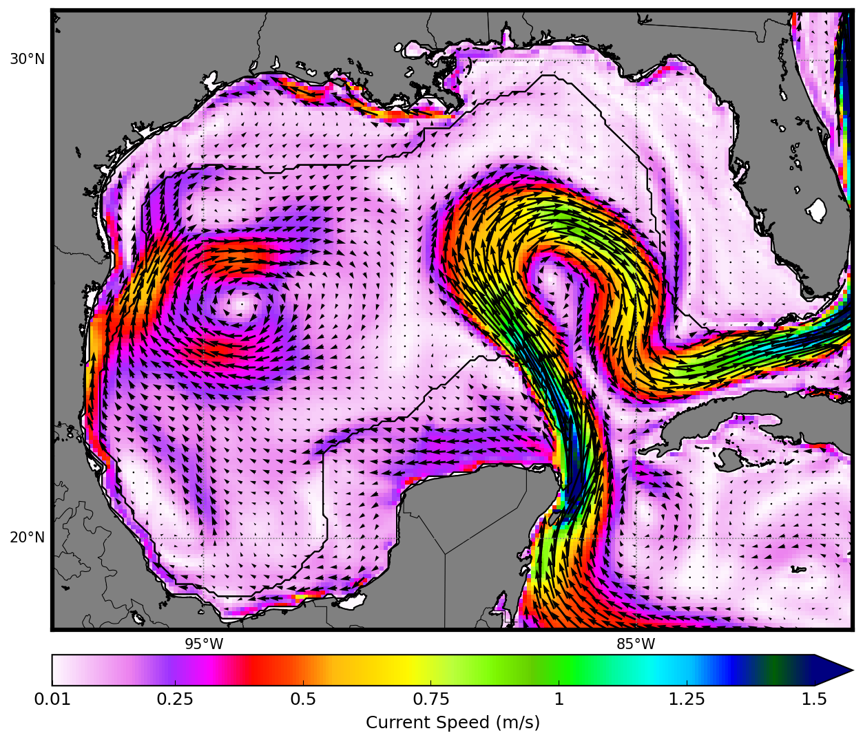
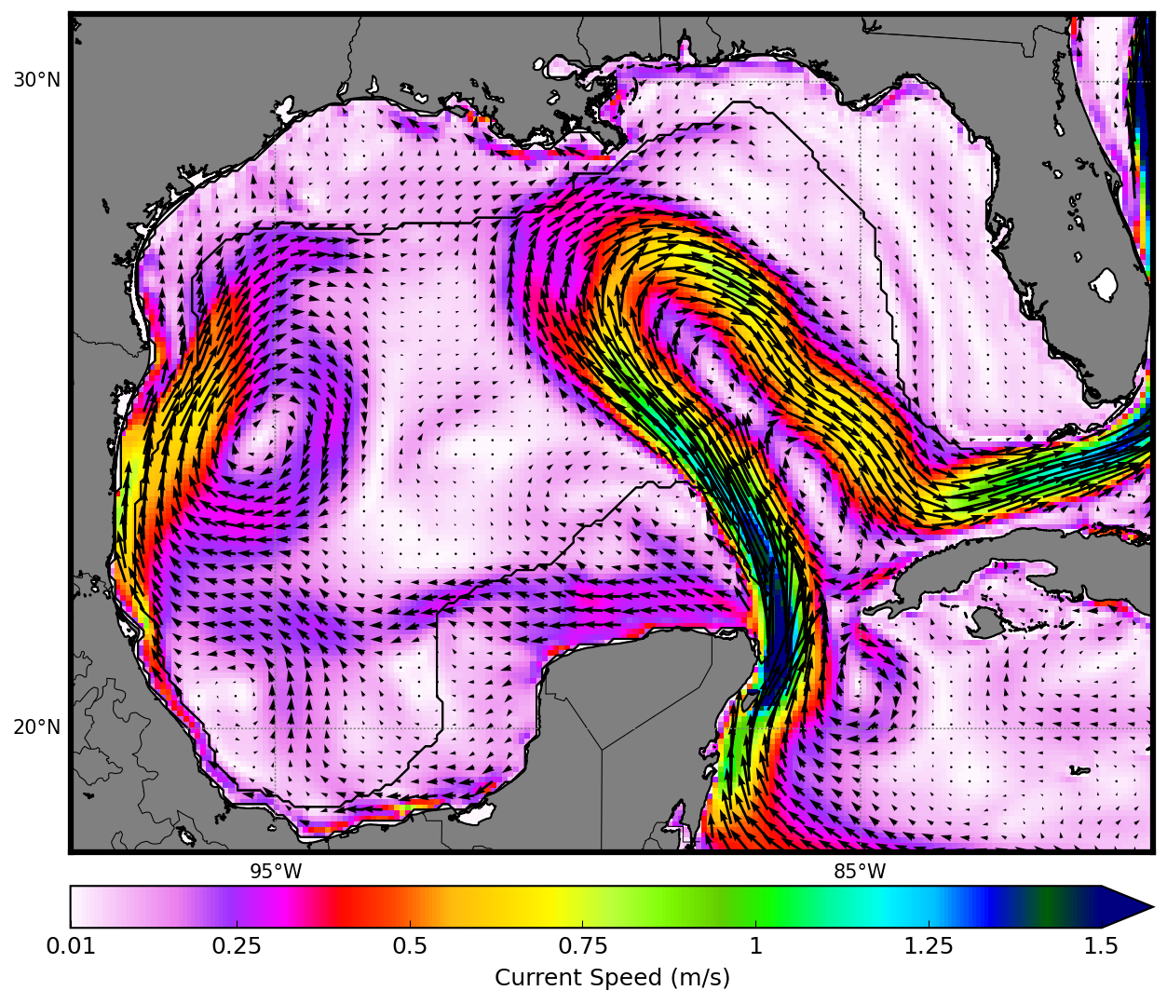
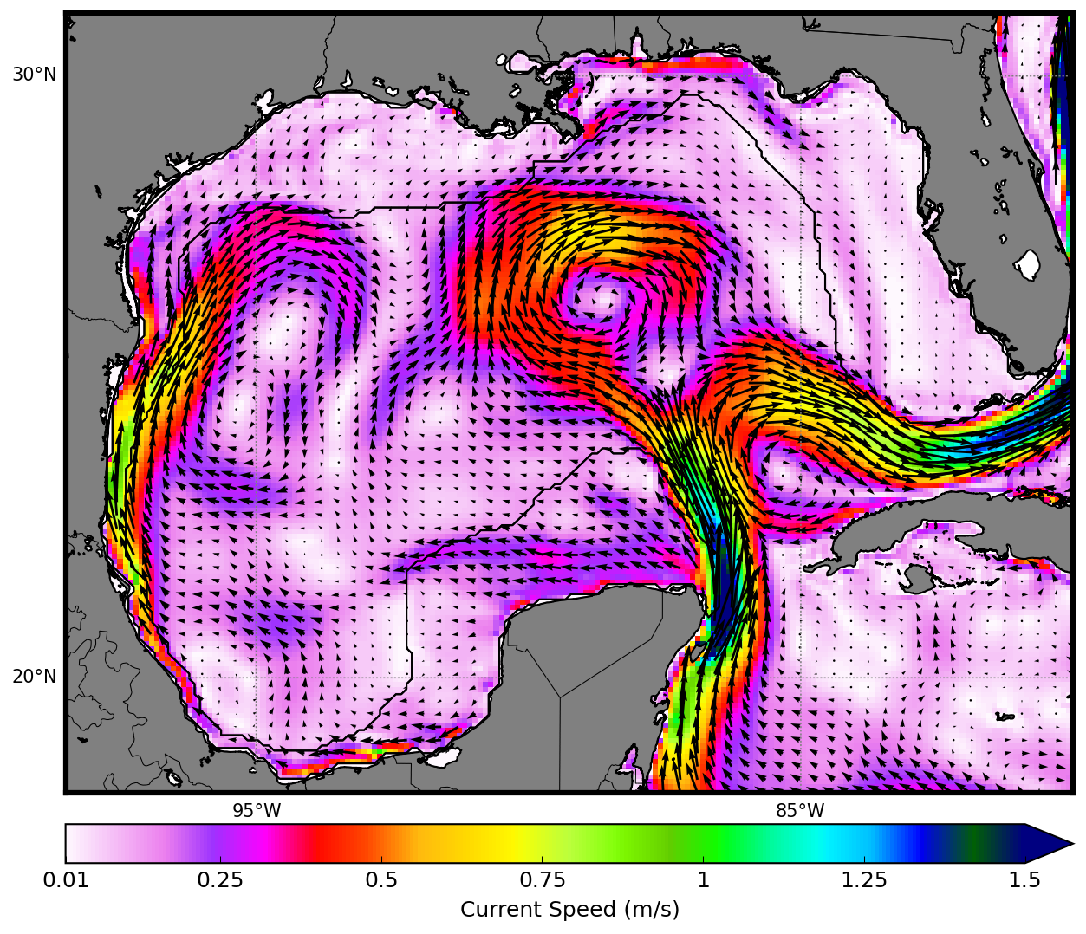
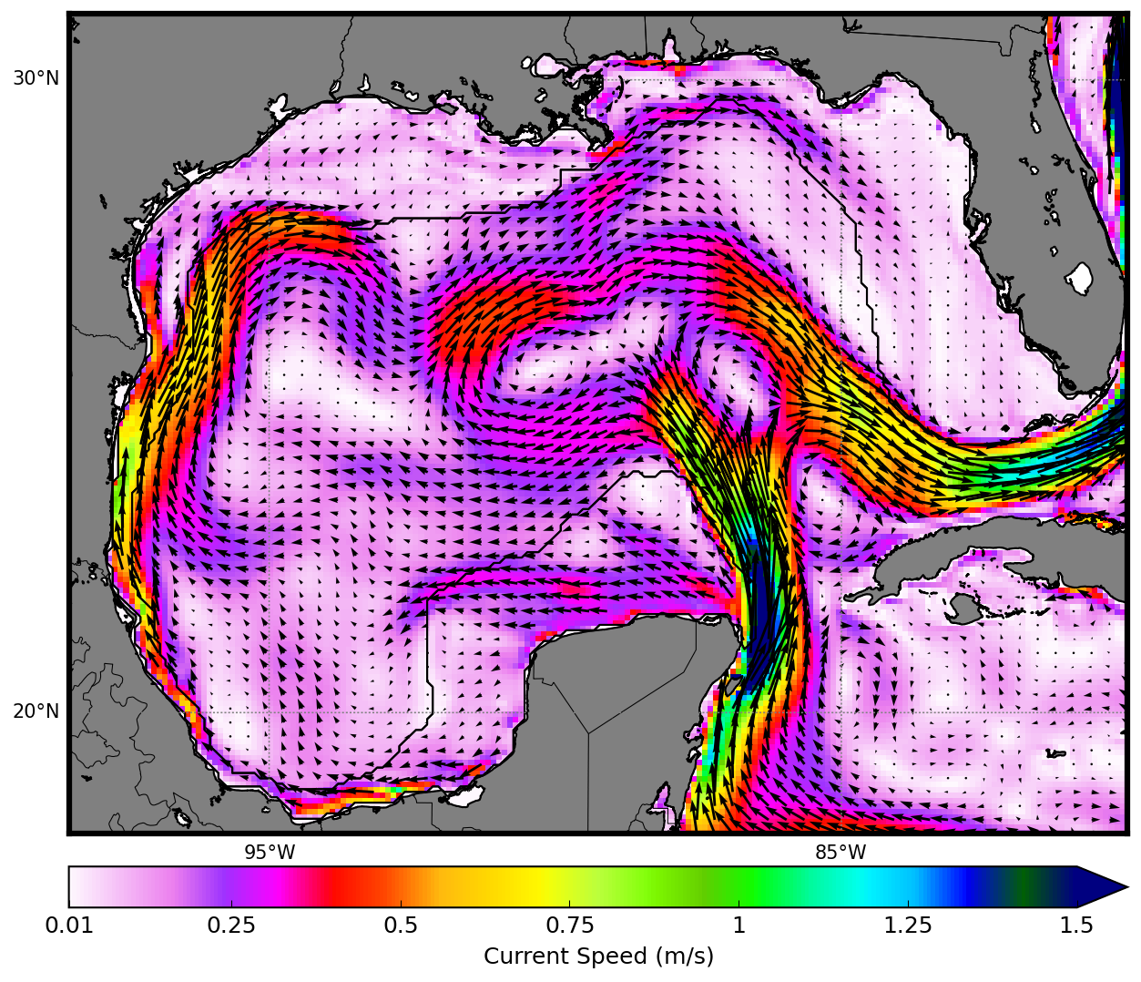
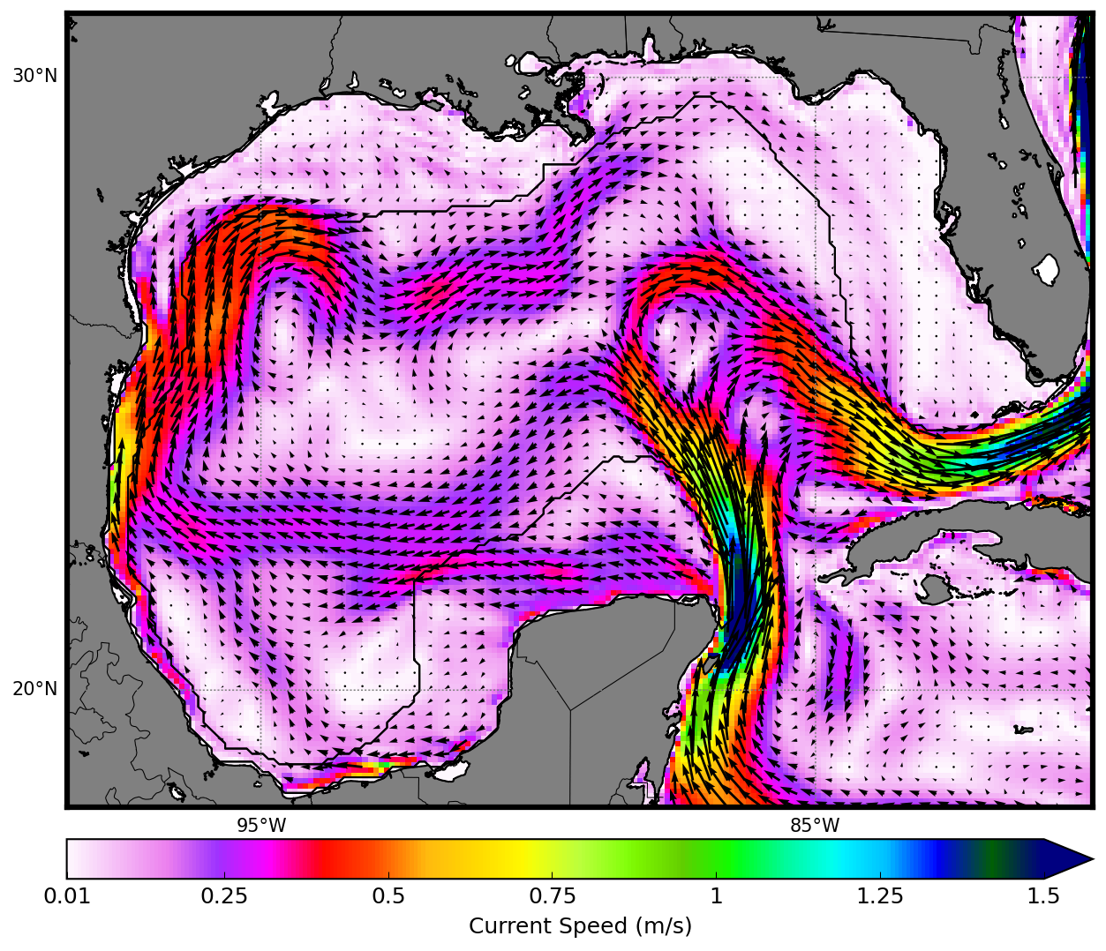
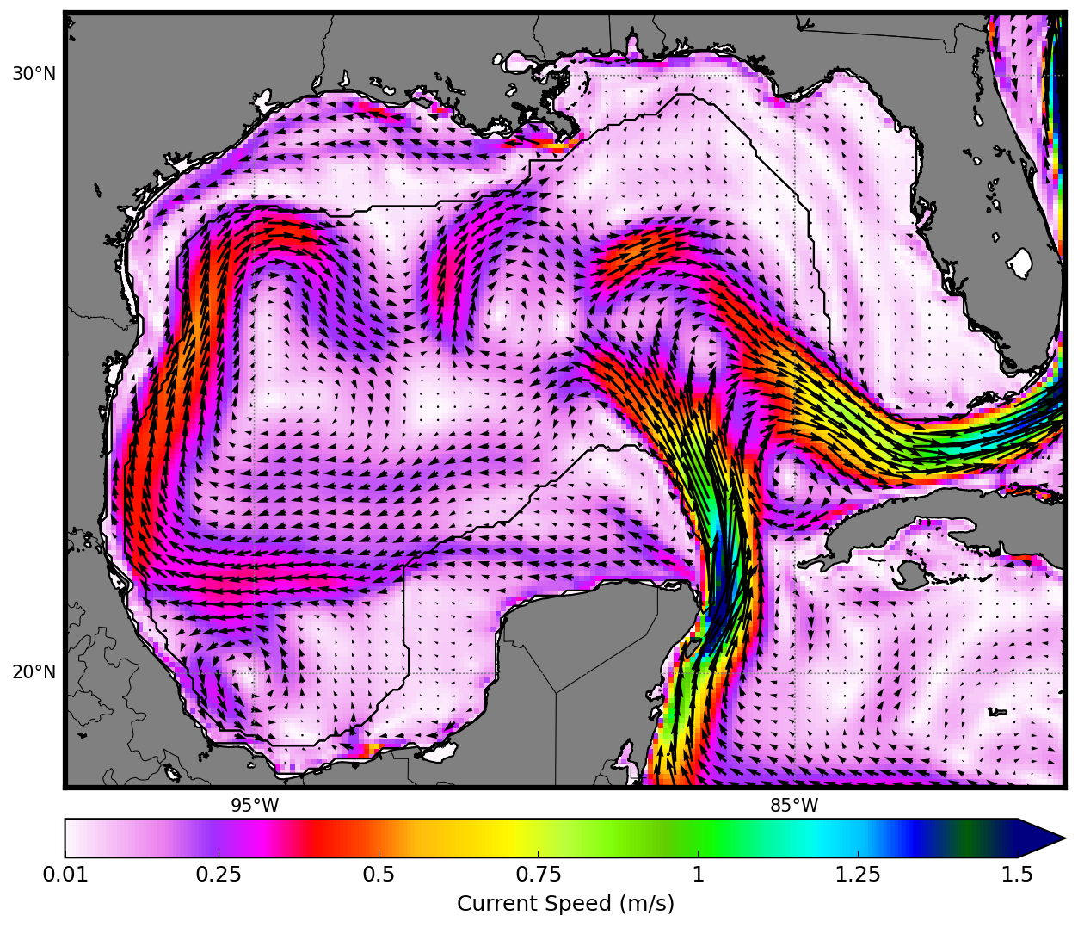
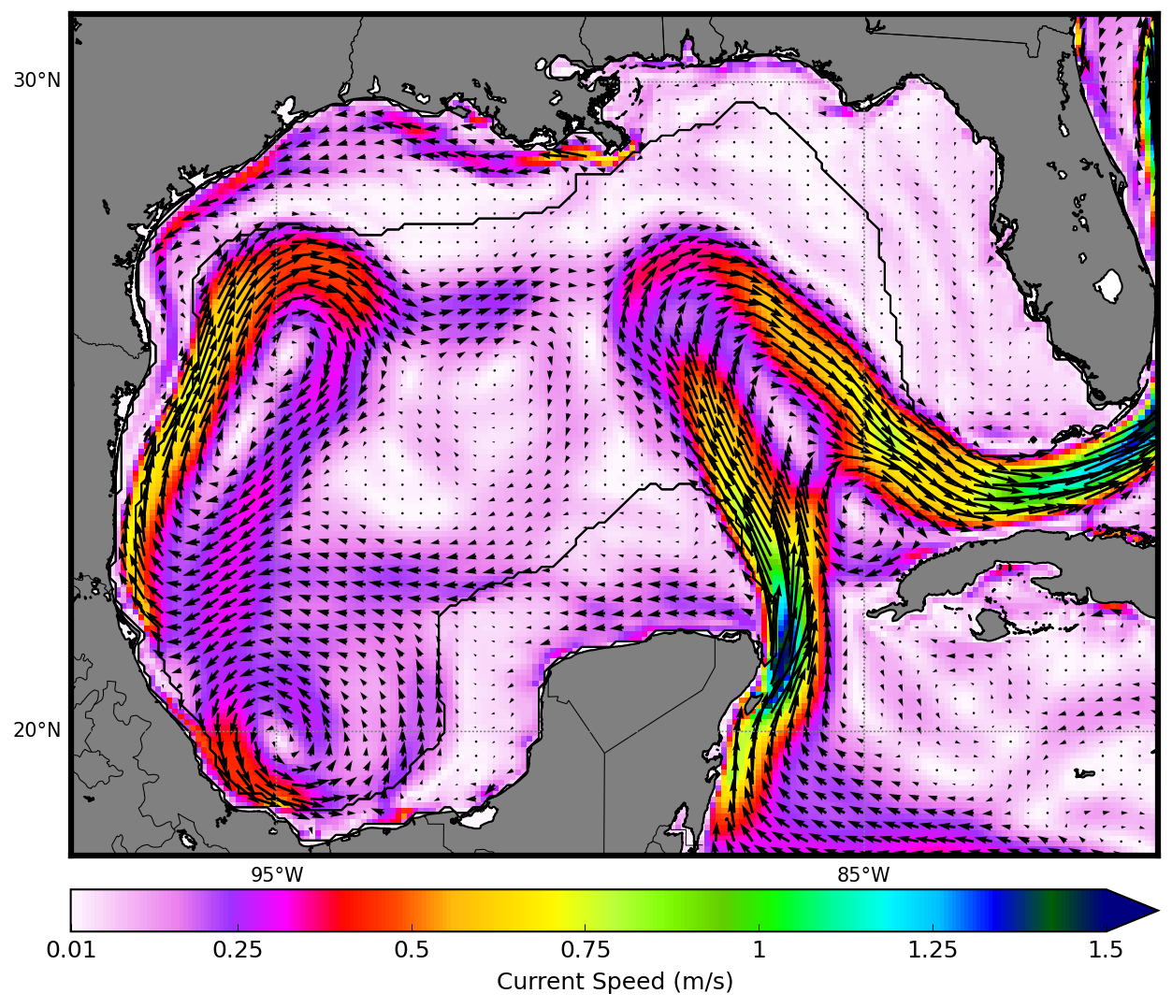
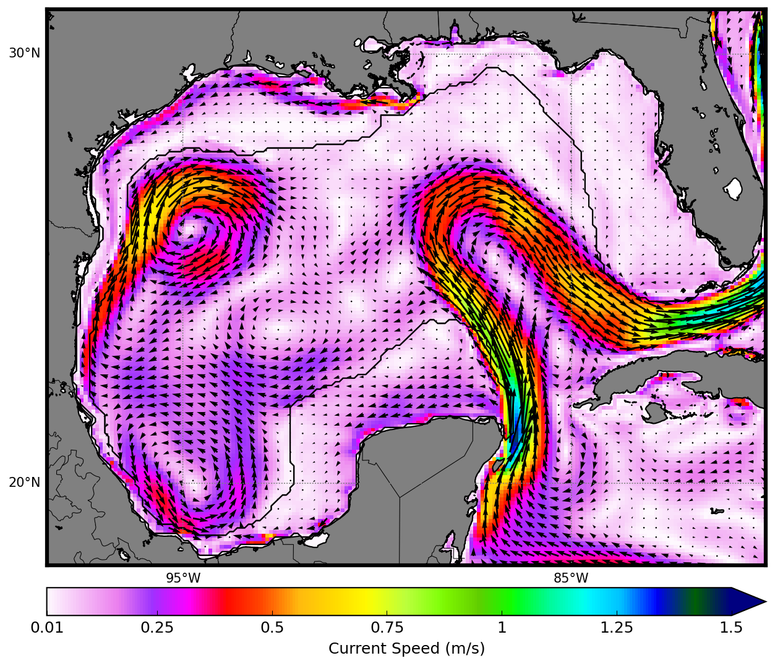
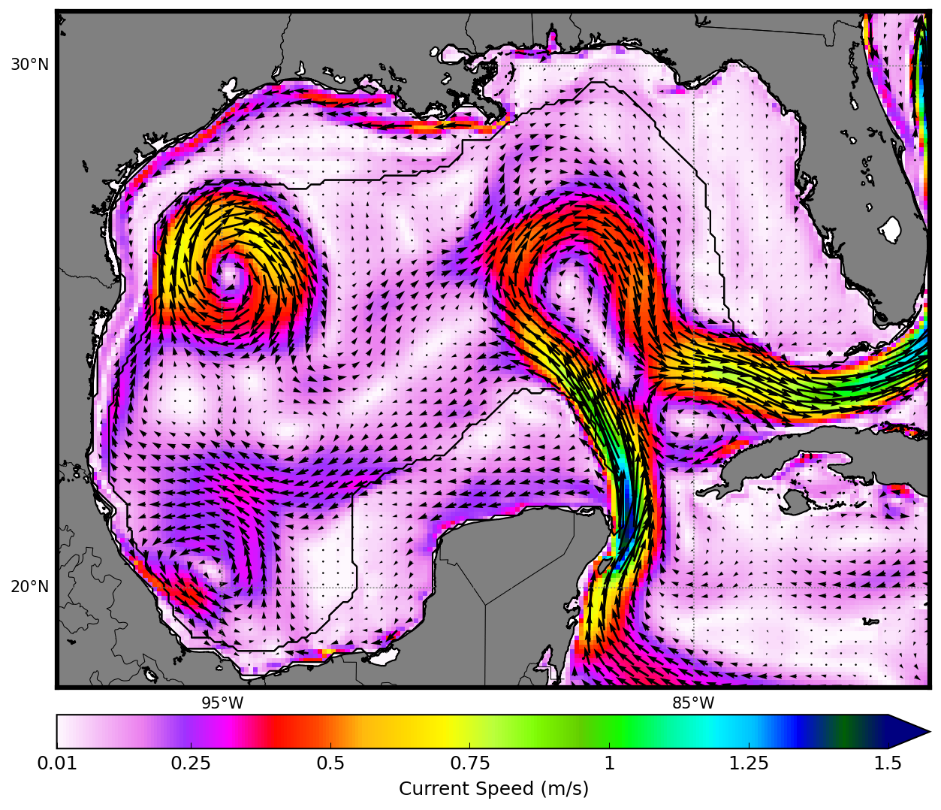
Jan
Feb
Mar
Apr
May
Jun
Jul
Aug
Sep
Oct
Nov
Dec
0.01
0.25
0.5
0.75
1.0
1.25
1.5
Surface Currents (m/s)
Figure 5: Monthly mean surface velocities (arrows) and current speeds (color shading). Currents less than 0.5 cm/s have not been shaded.

Slide 6
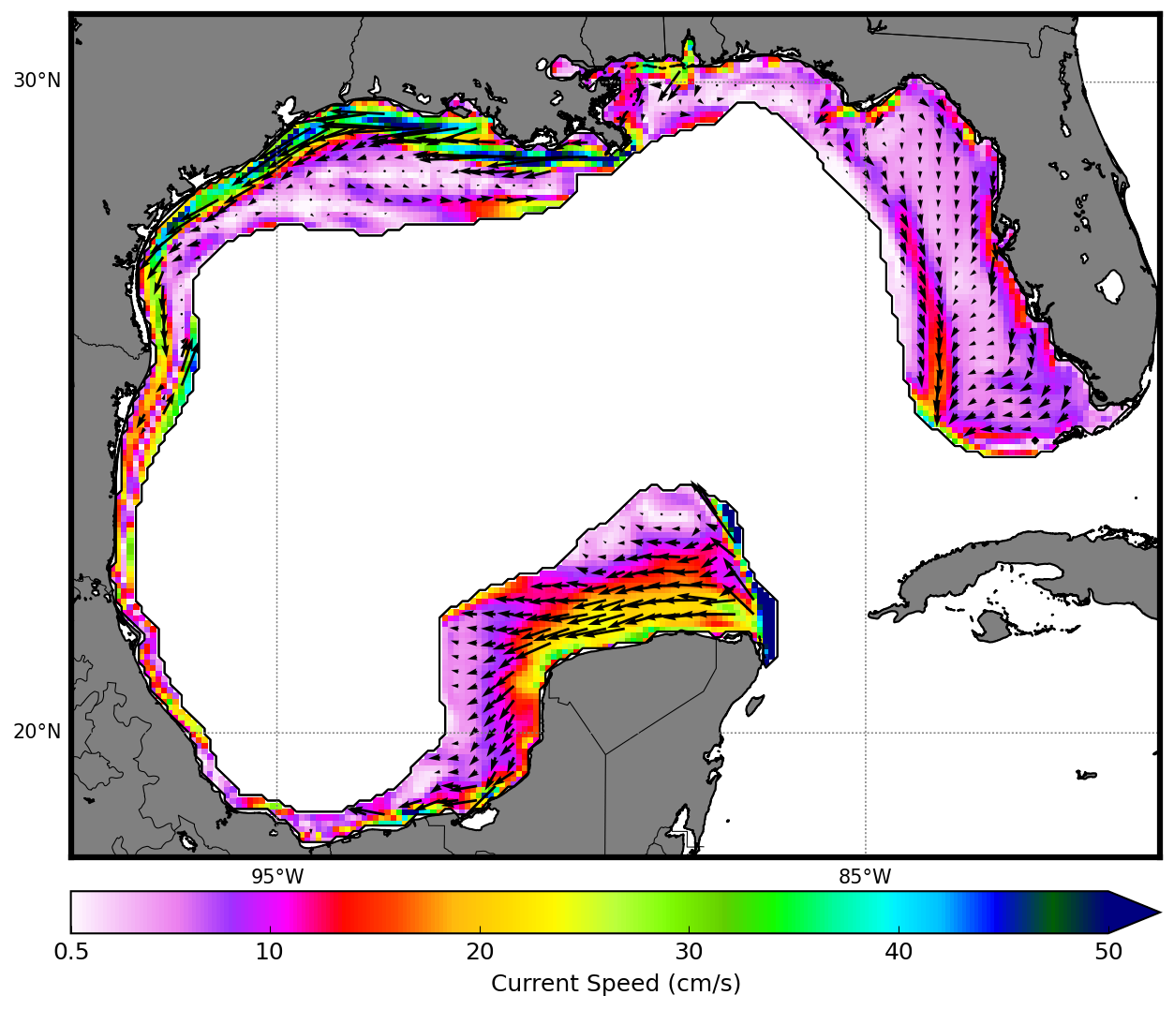
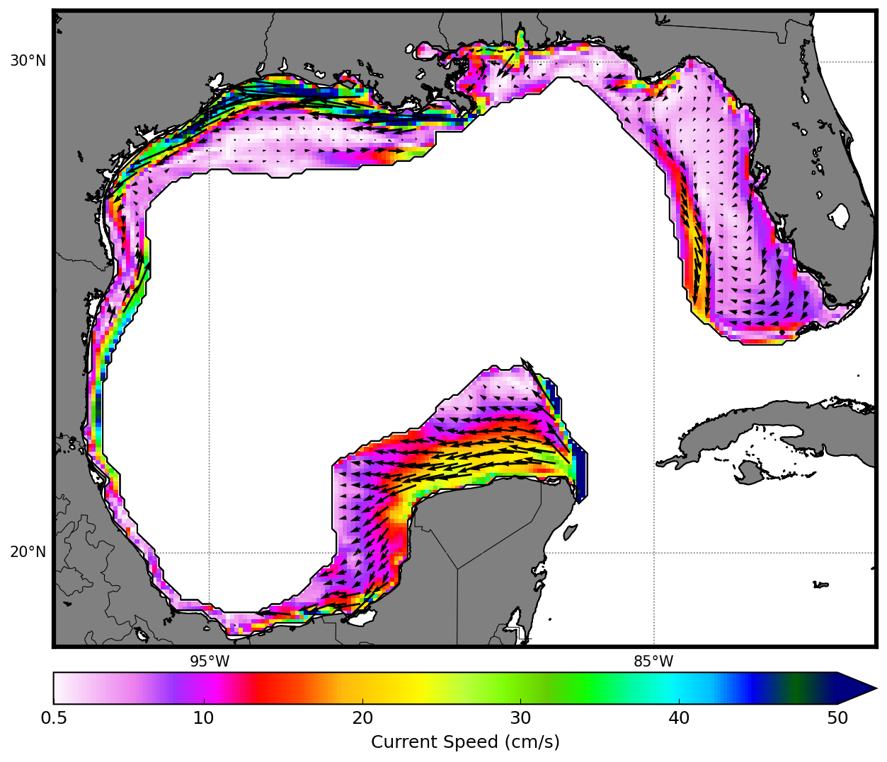
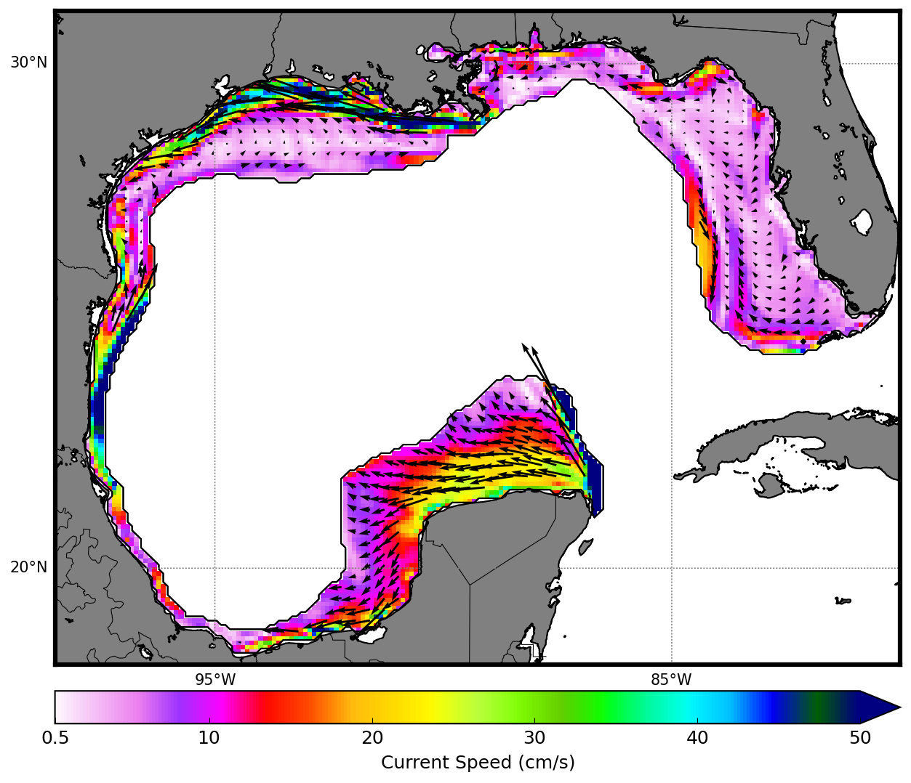
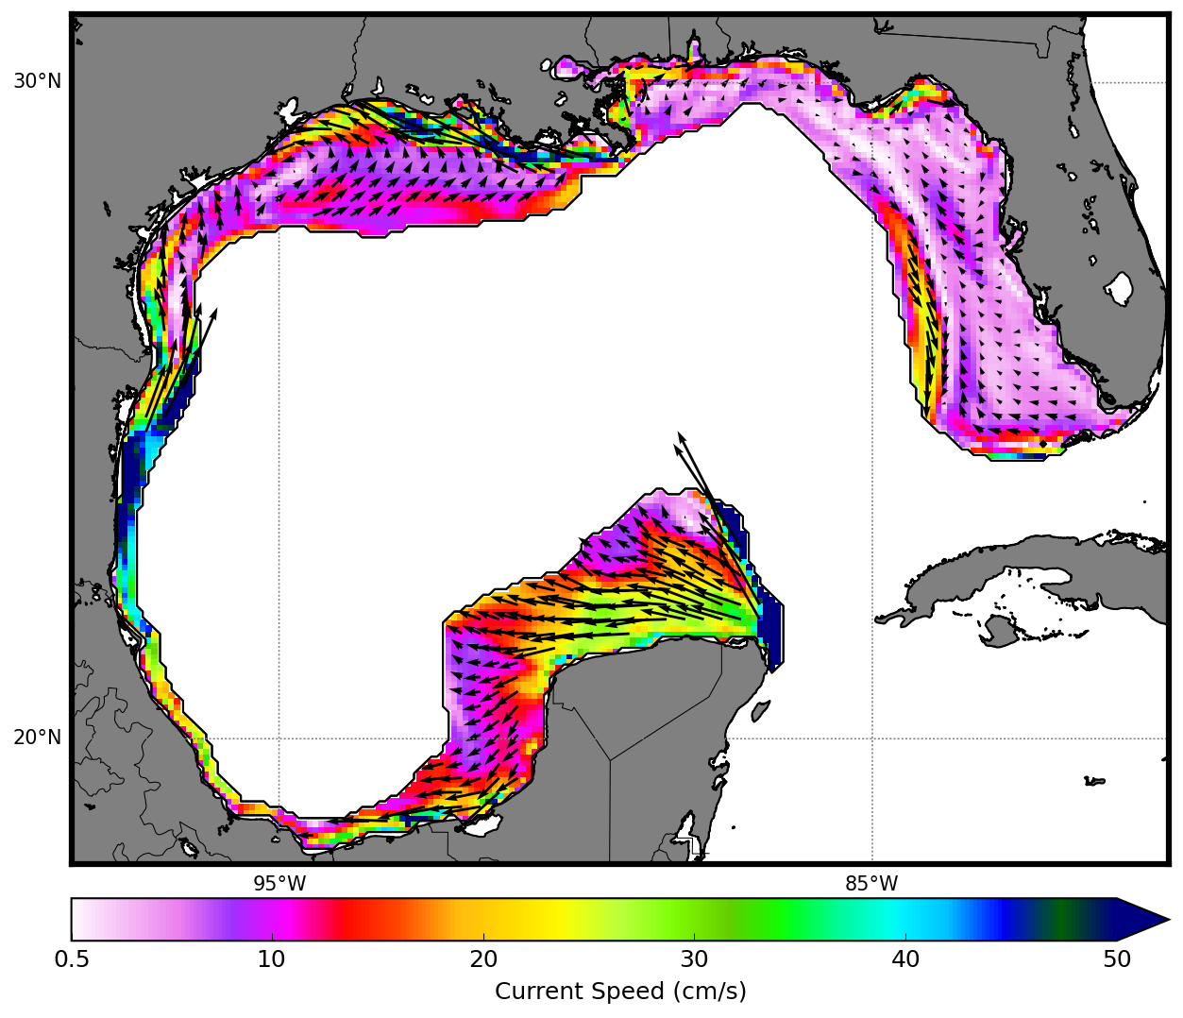
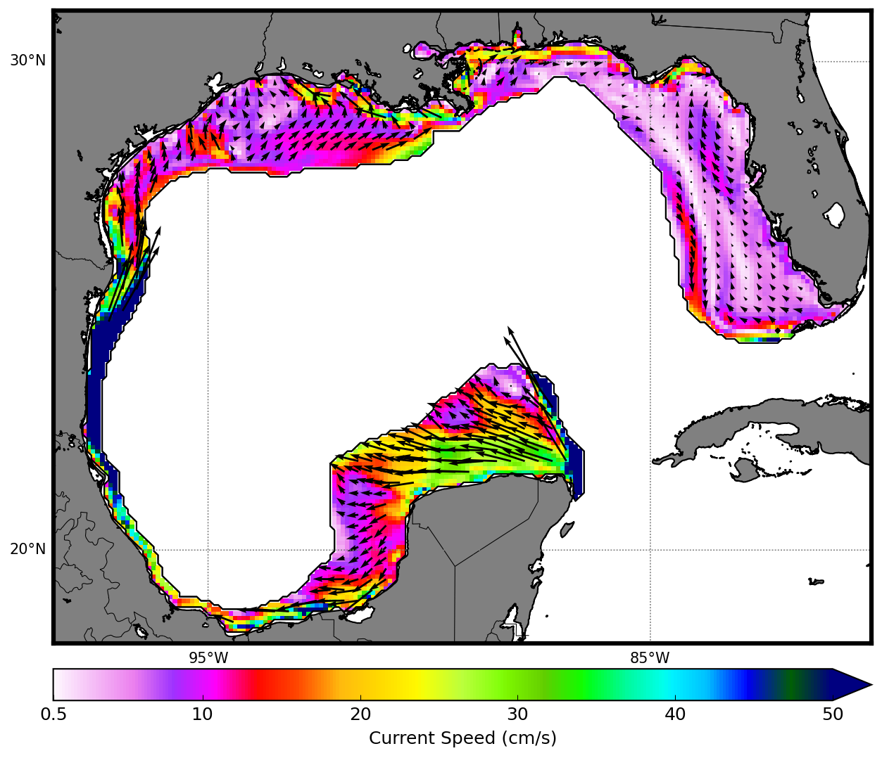
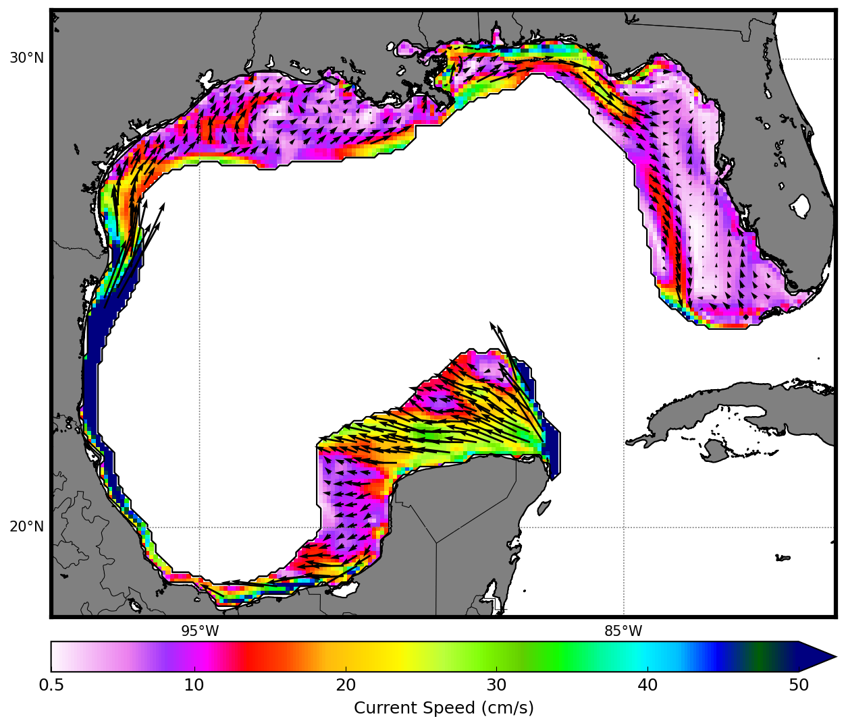
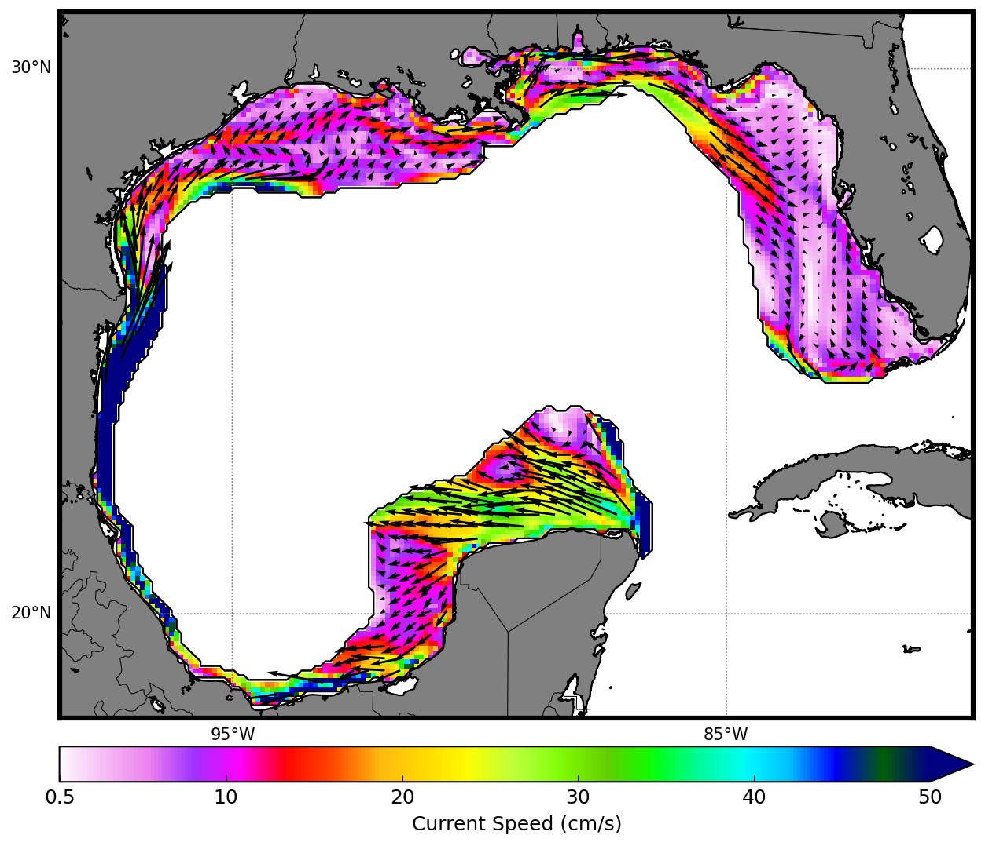
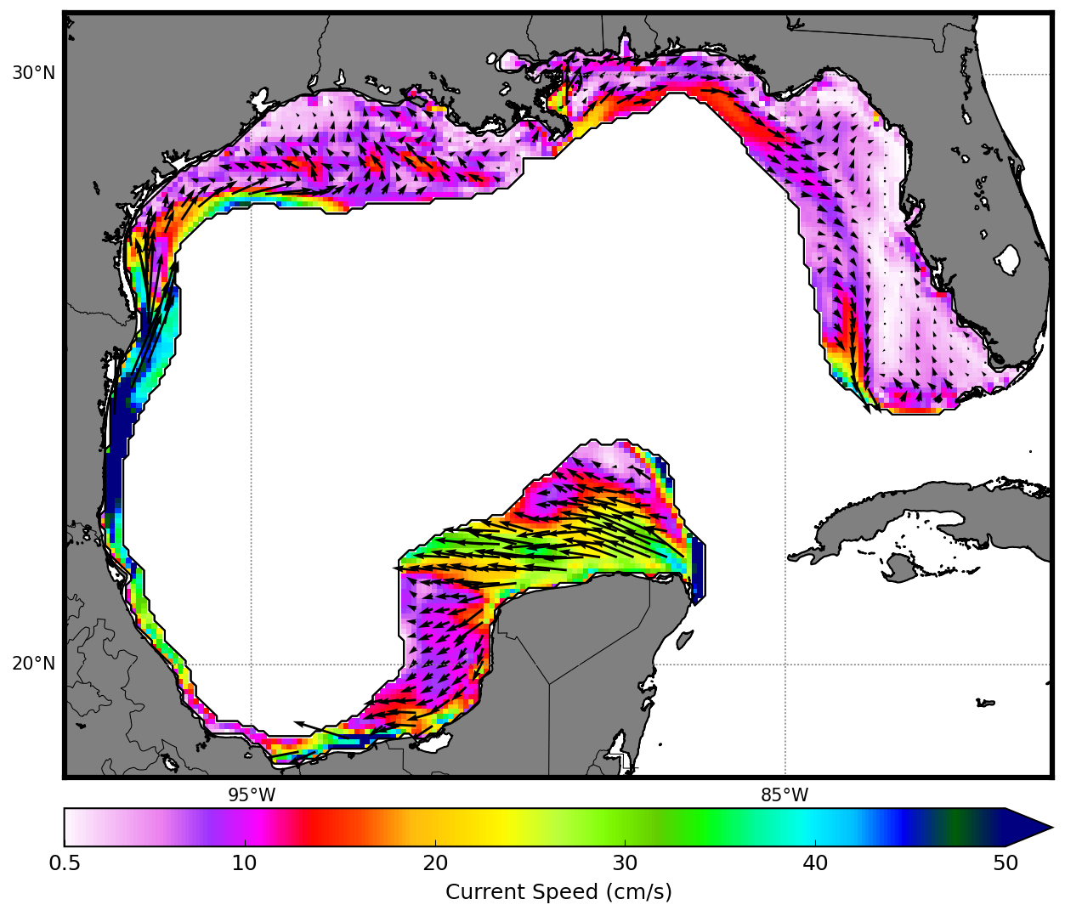
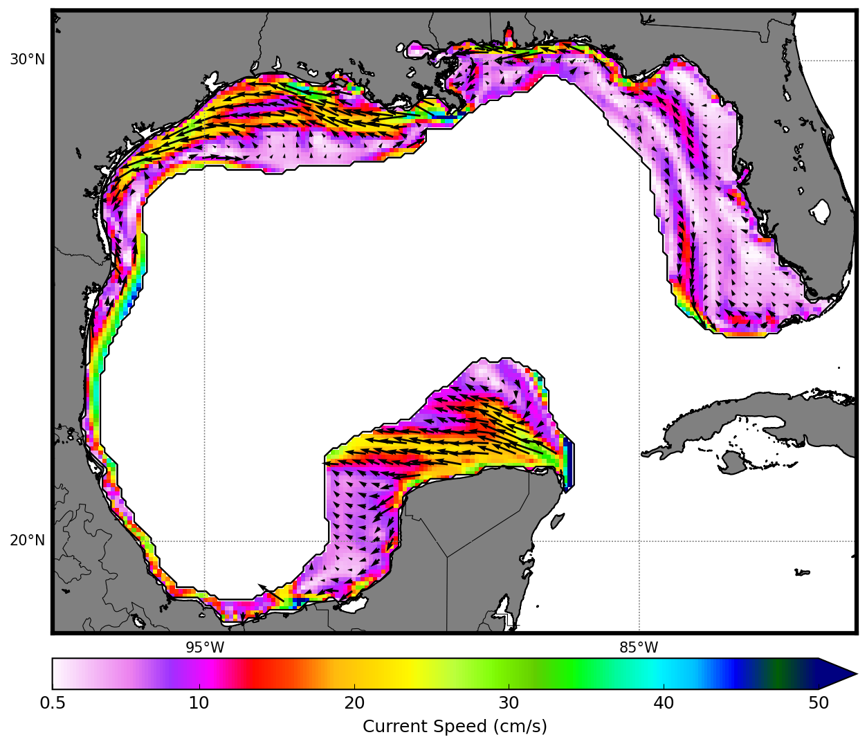

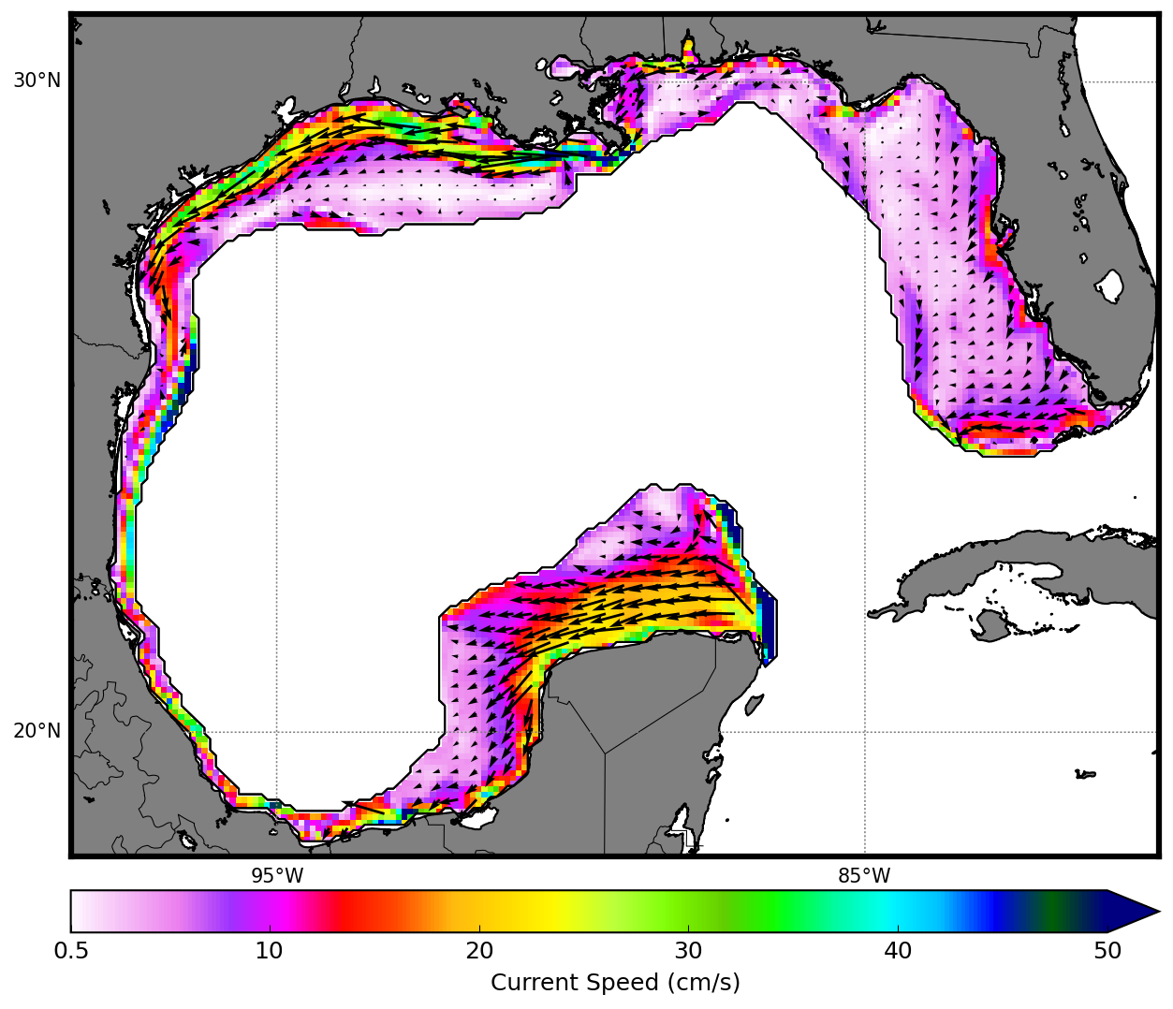
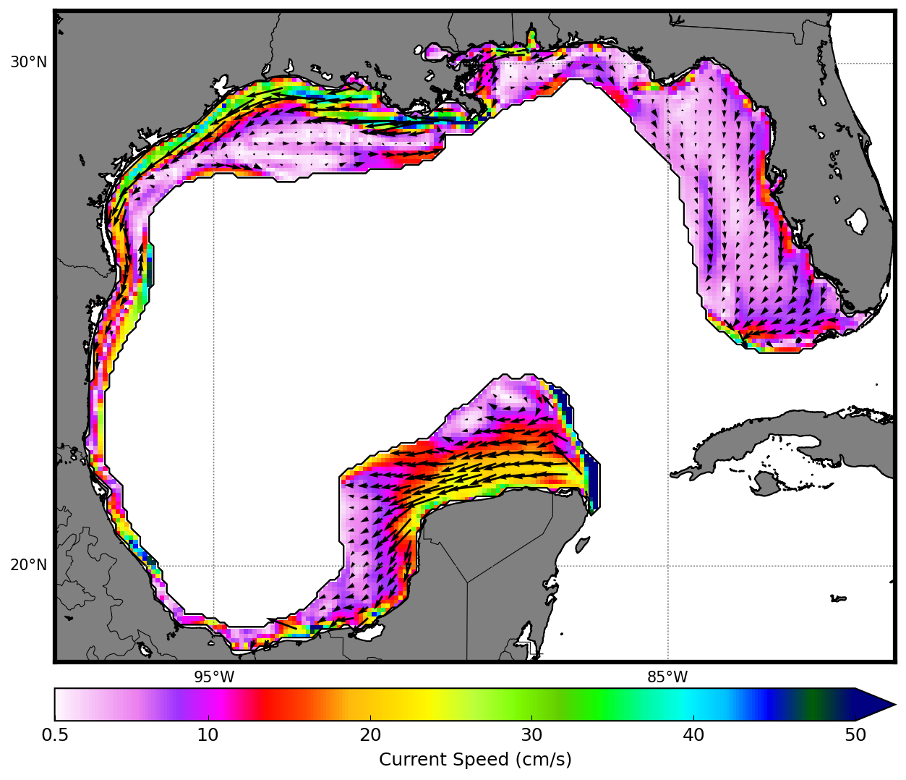
Jan
Feb
Mar
Apr
May
Jun
Jul
Aug
Sep
Oct
Nov
Dec
0.5
10
20
30
40
50
Surface Currents (cm/s)
Figure 6: Monthly mean surface velocities (arrows) and current speeds (color shading) within the Gulf of Mexico shelf domain. Currents less than 0.5 cm/s have not been shaded.

Slide 7
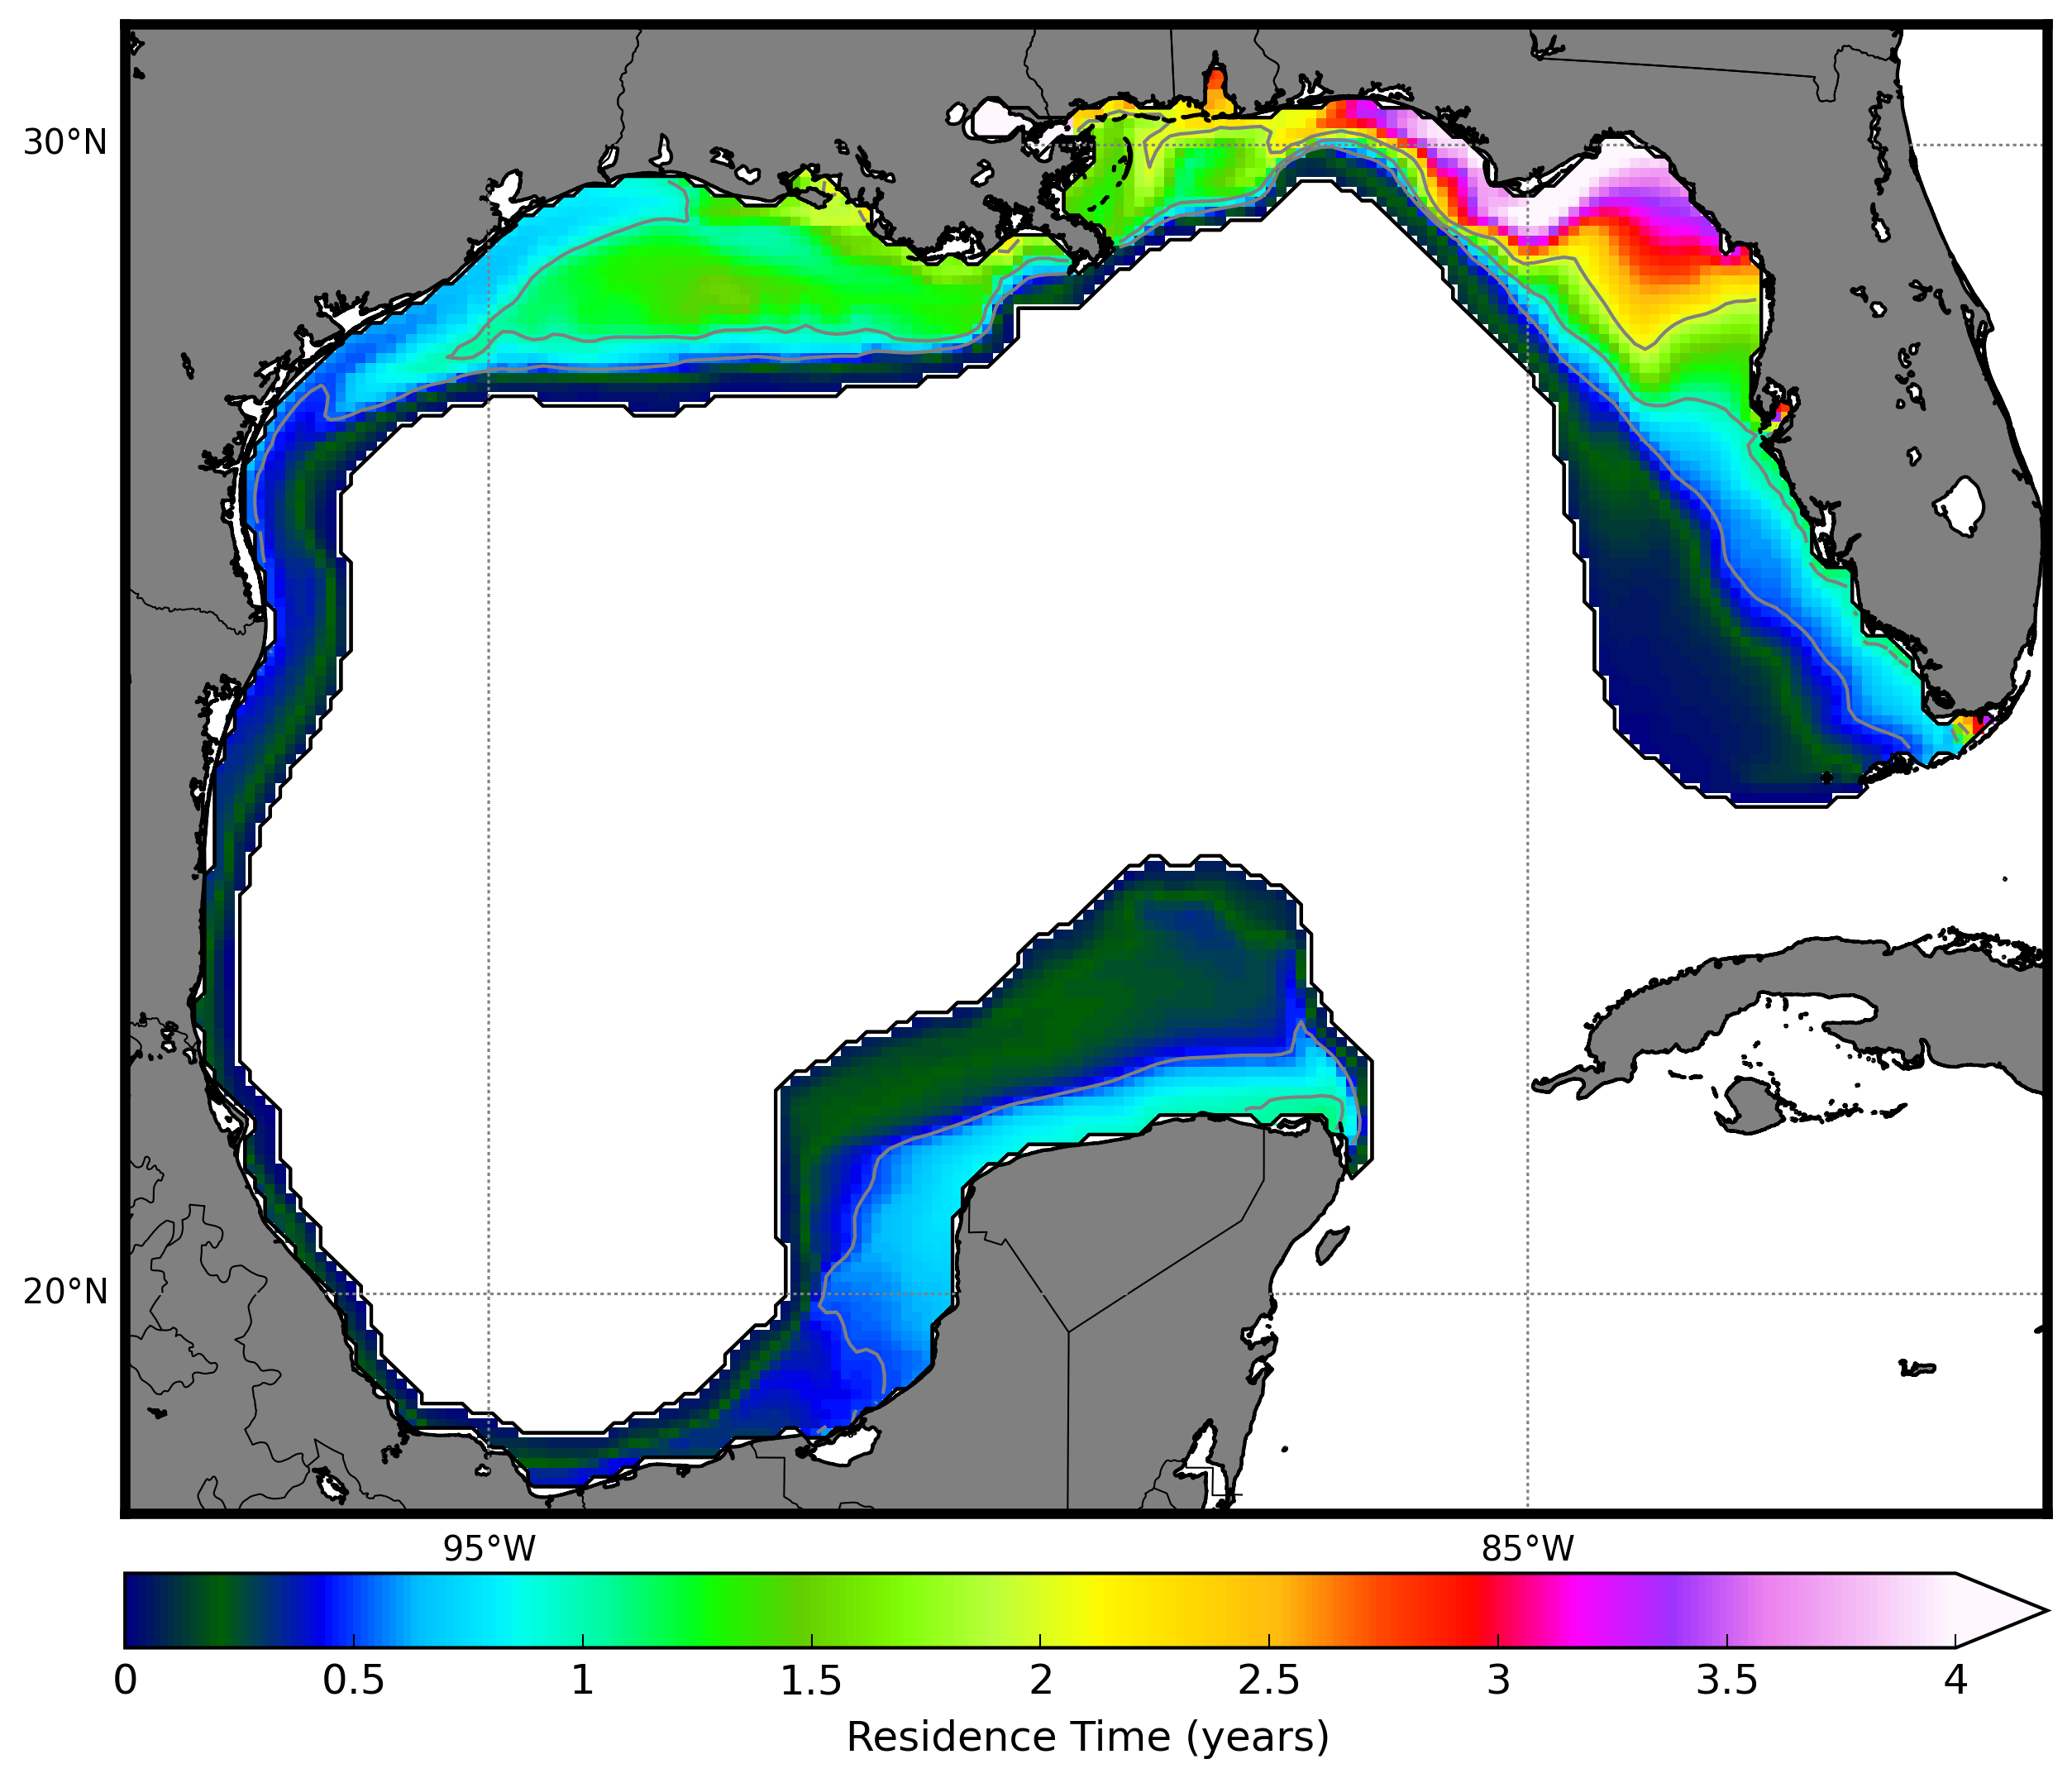
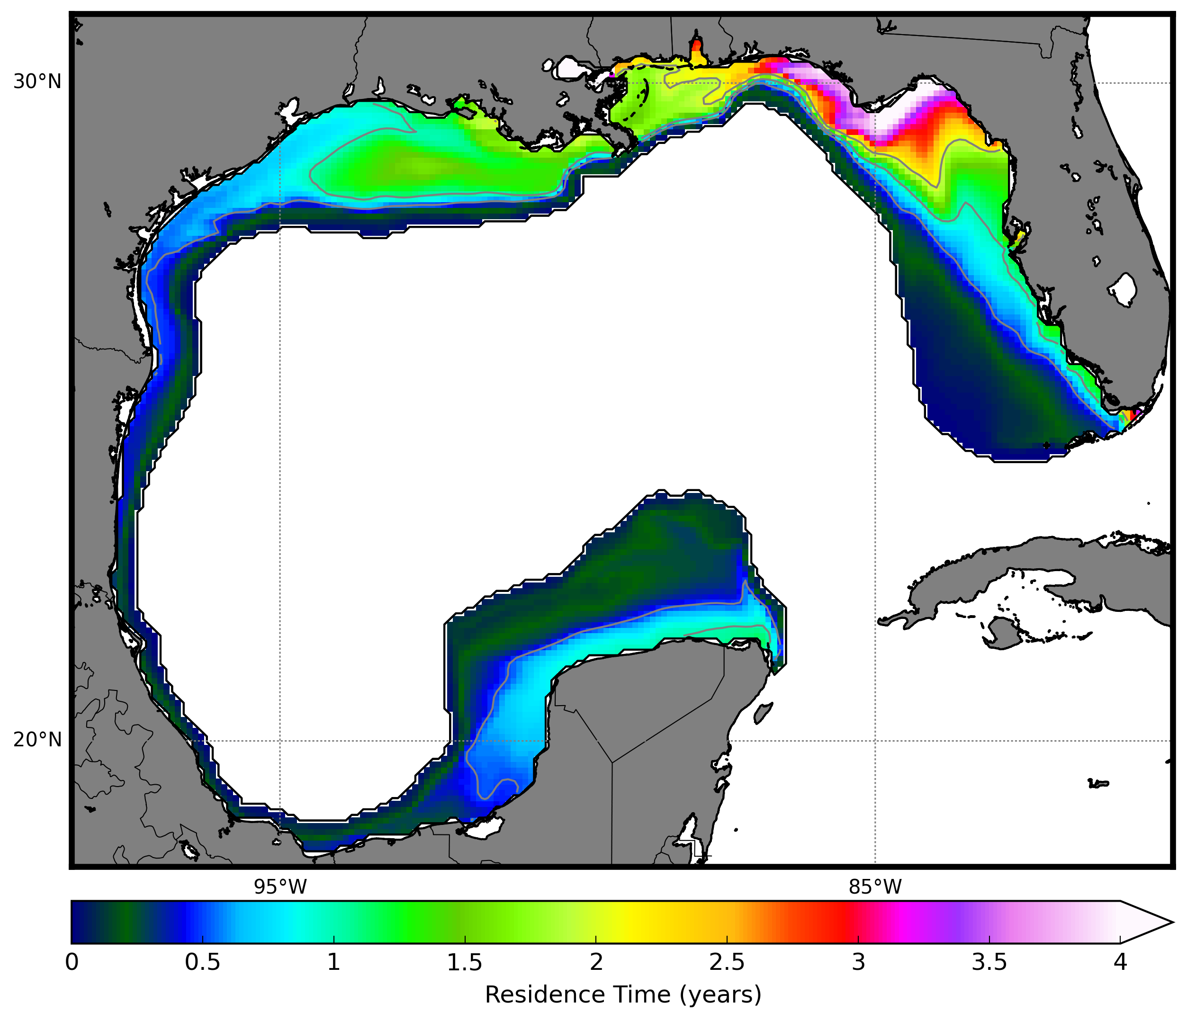
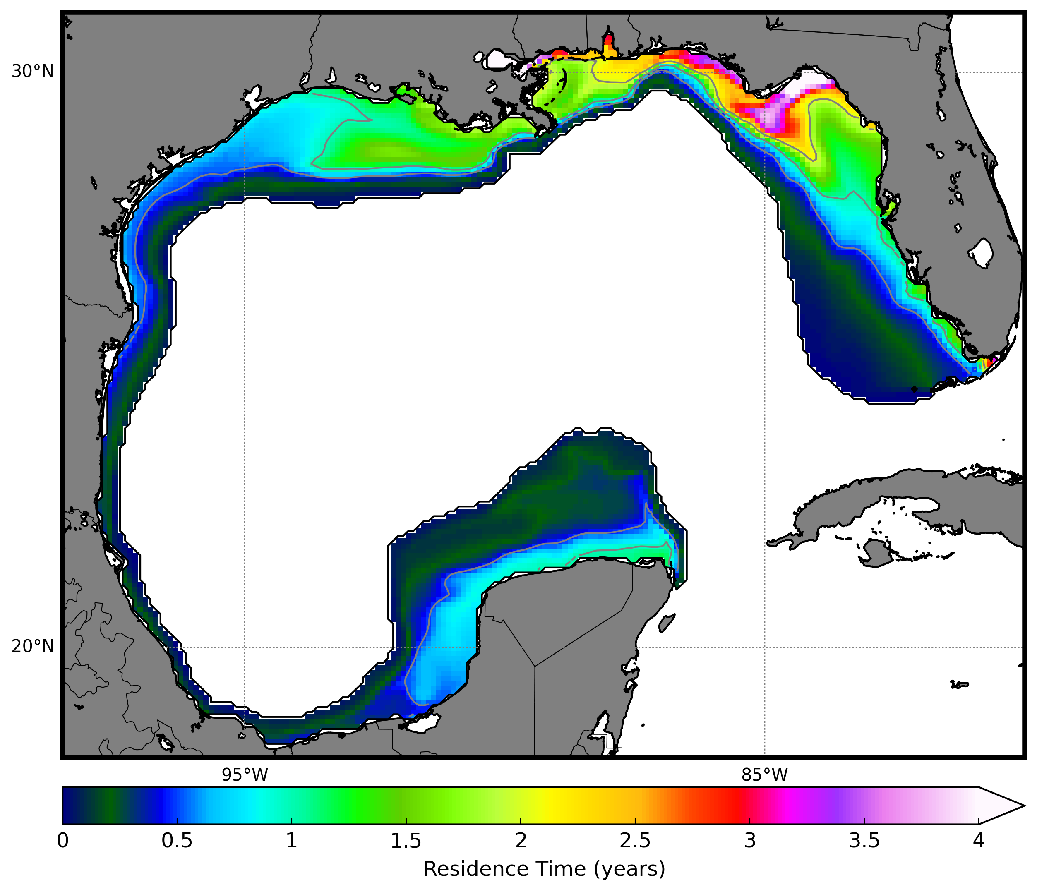
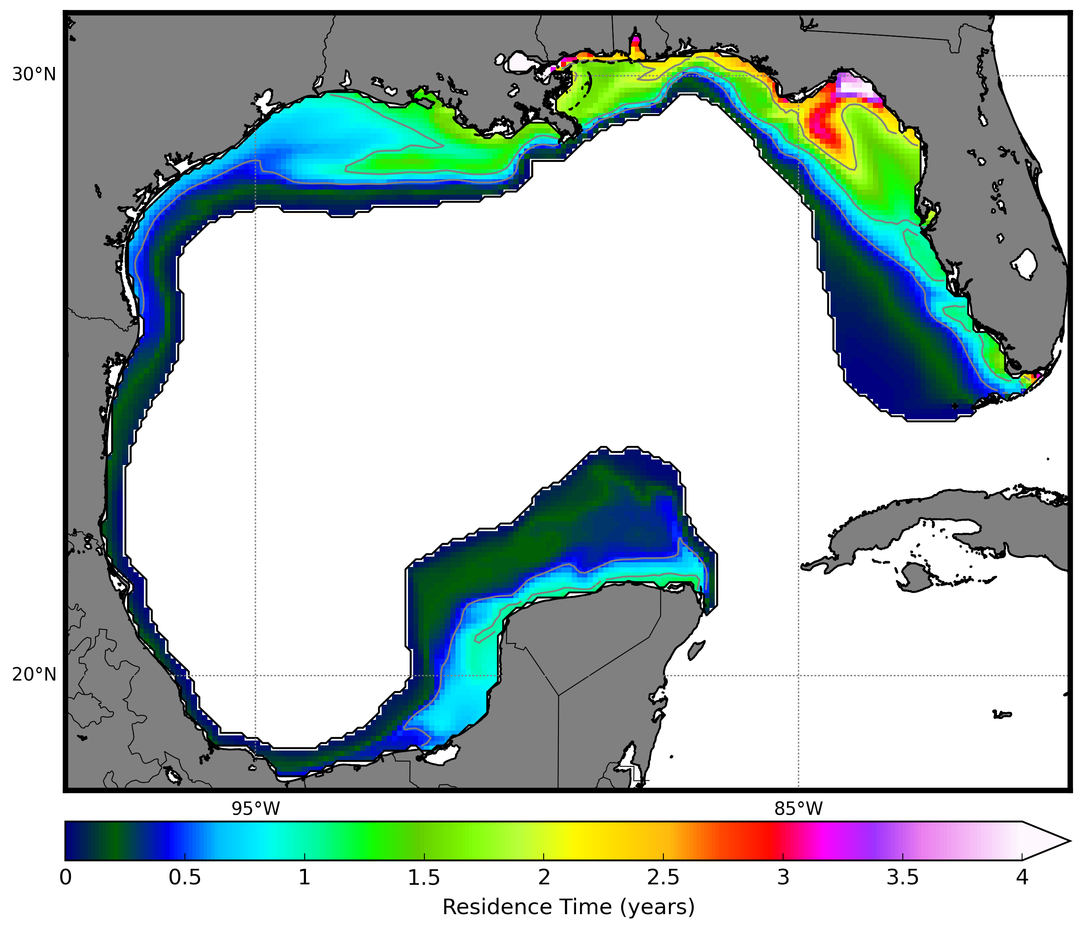

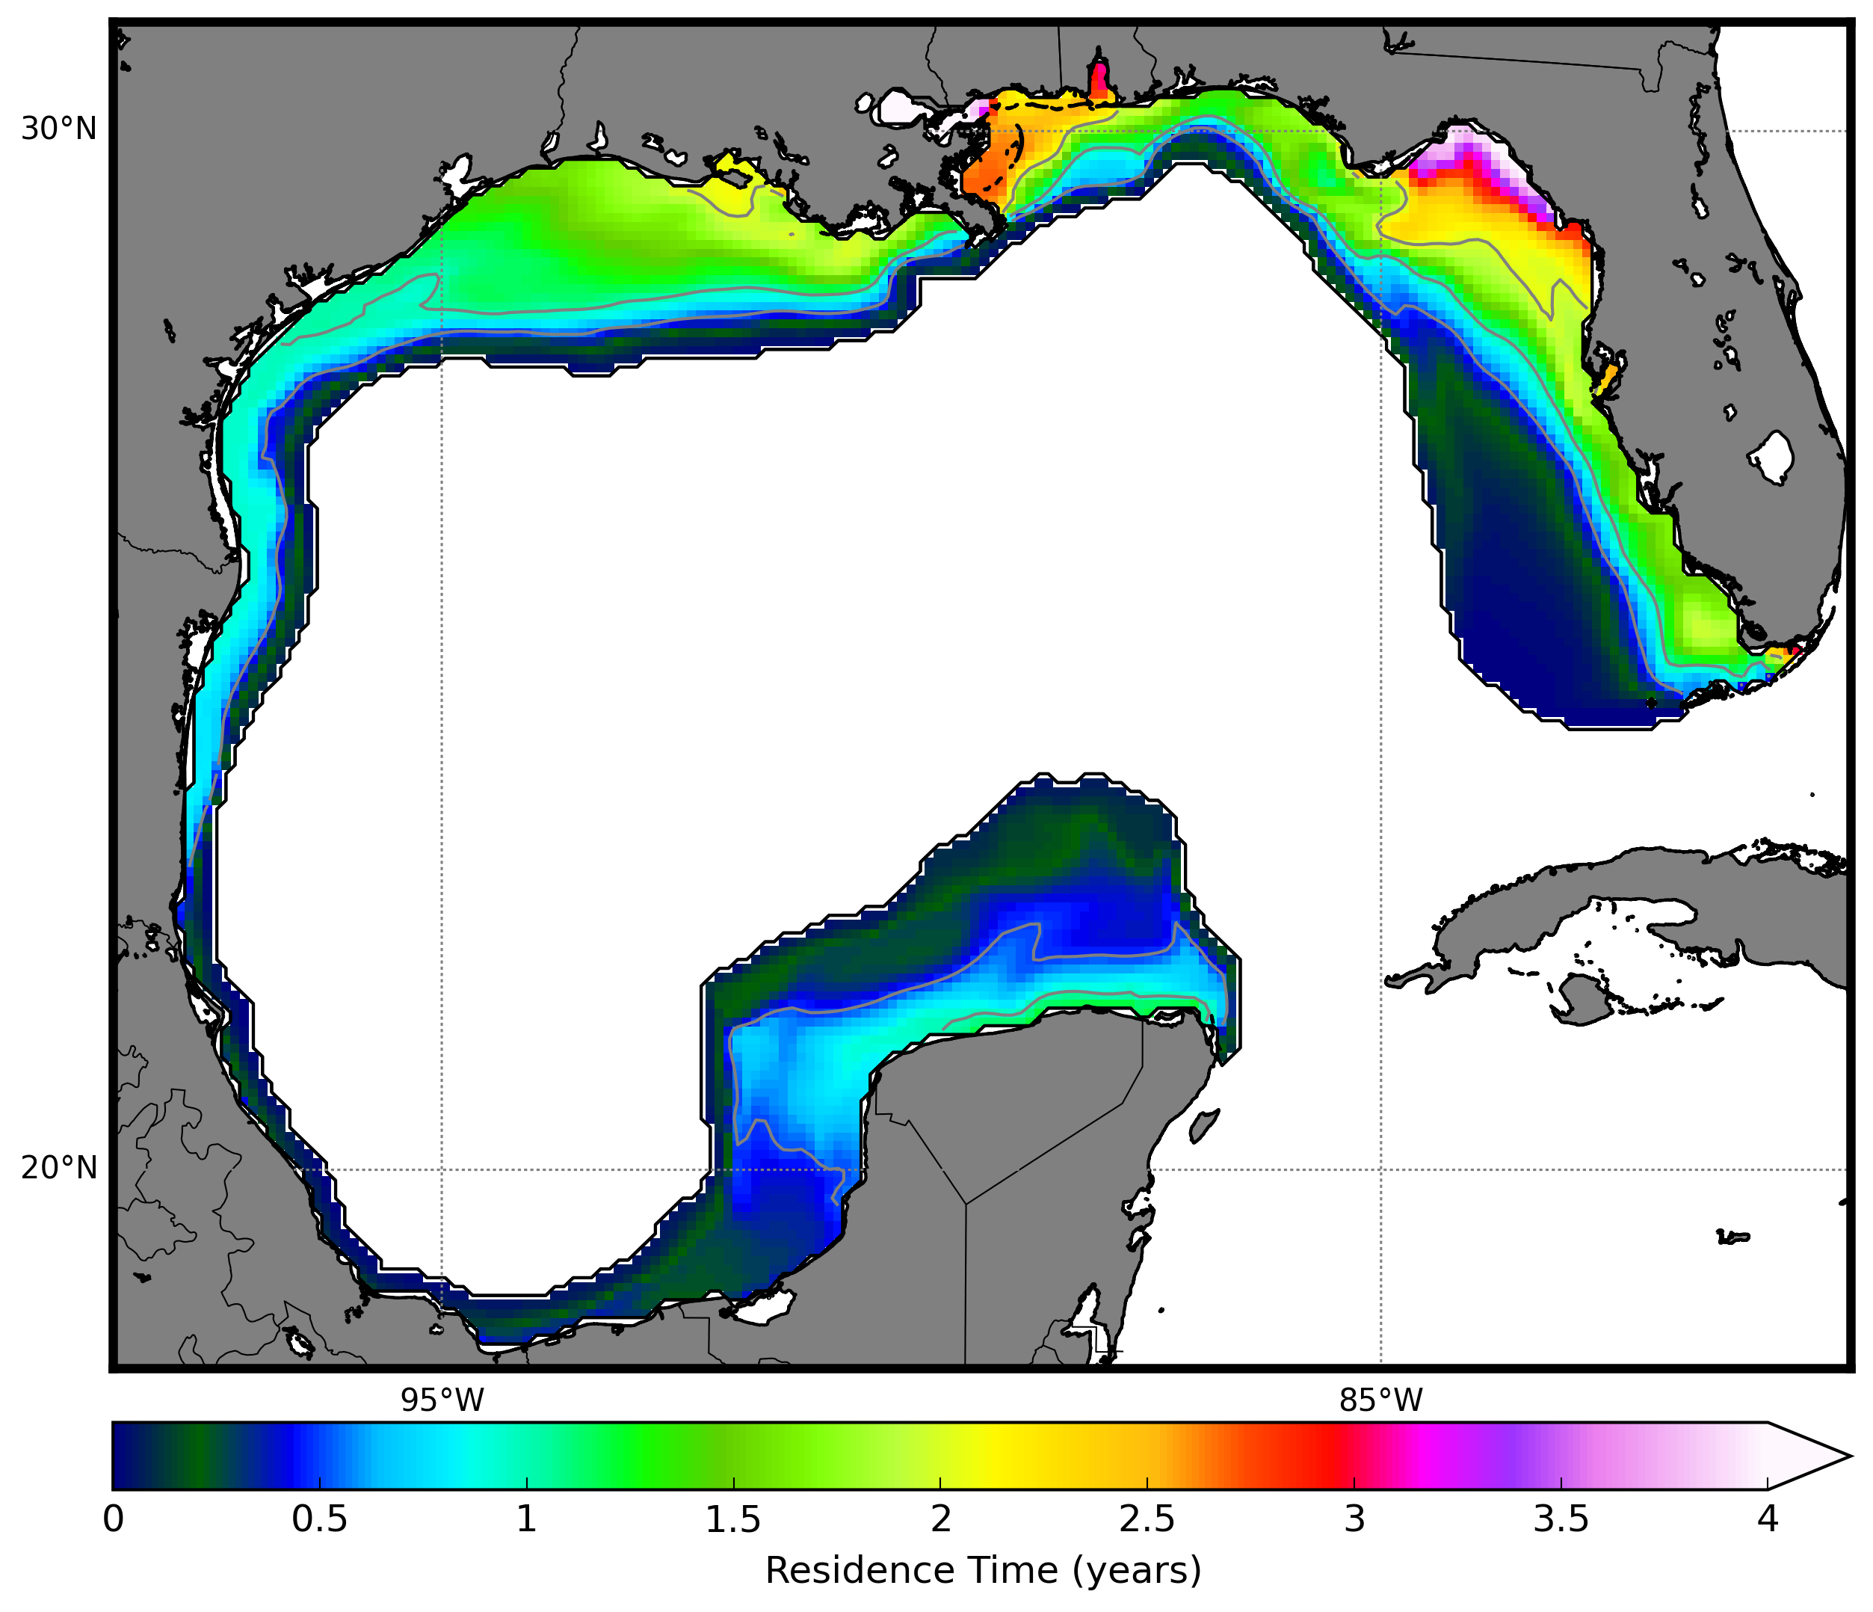
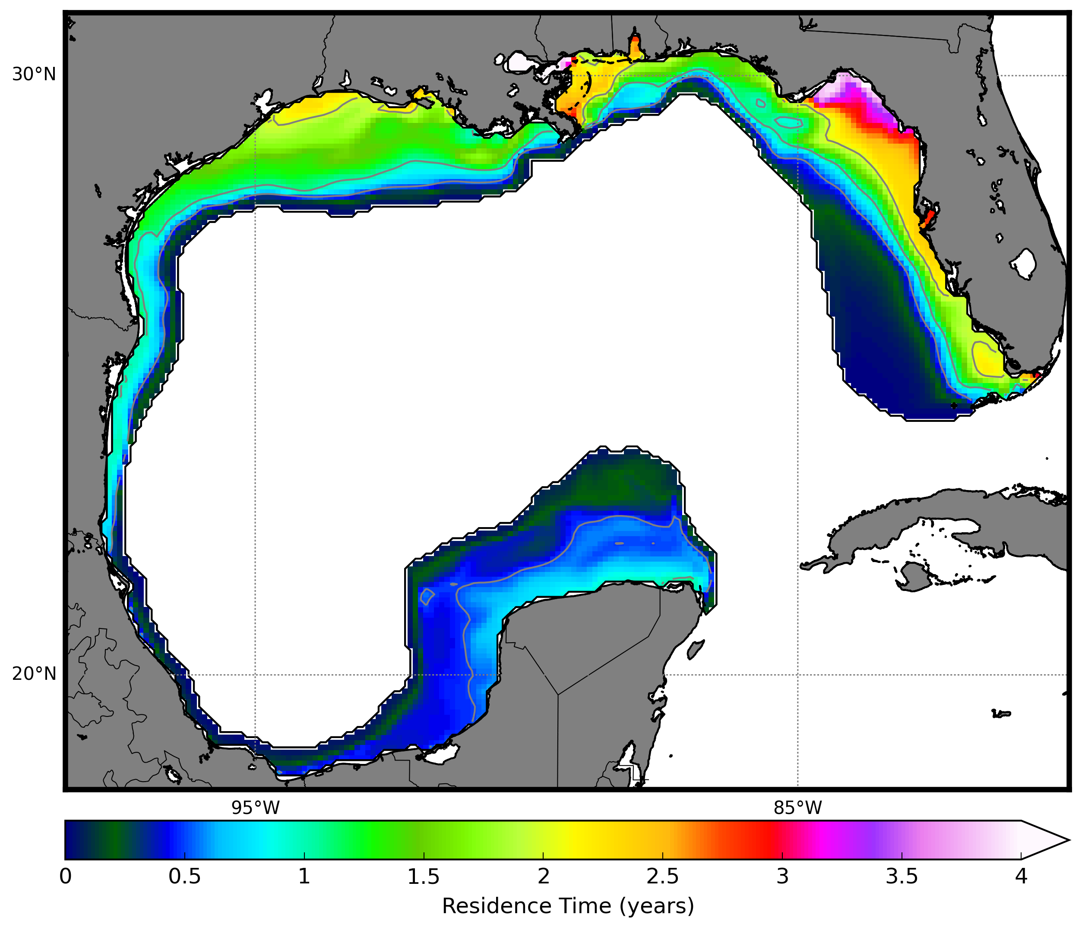
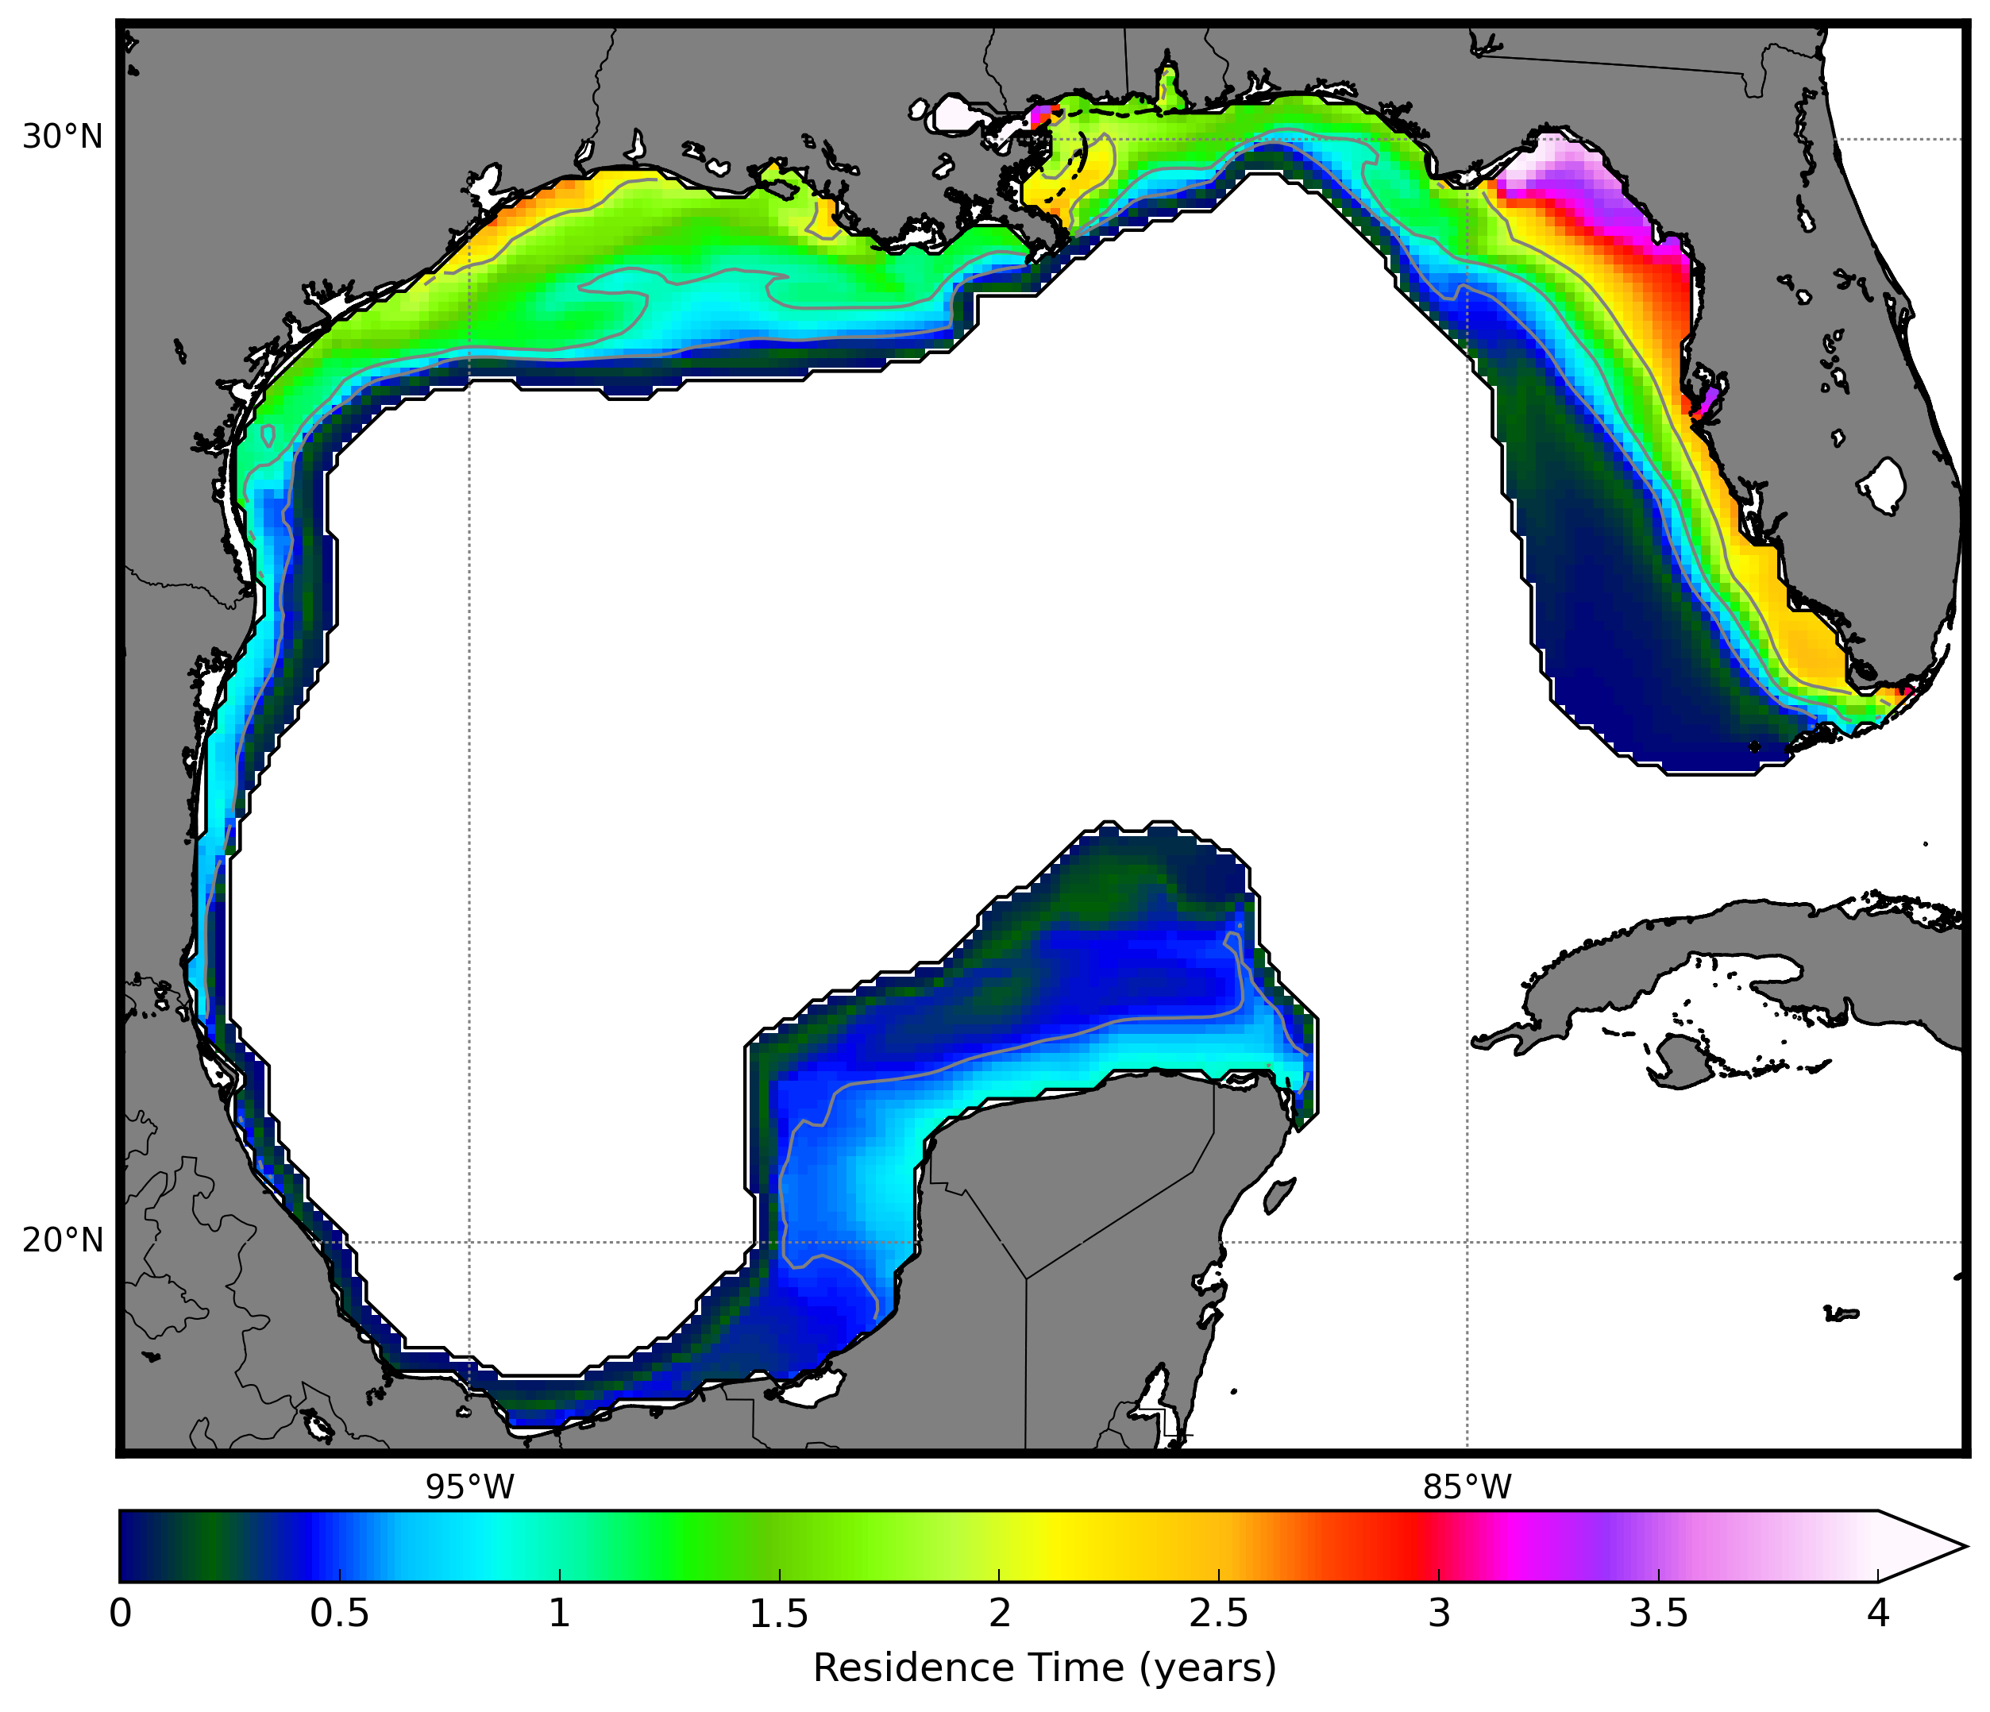
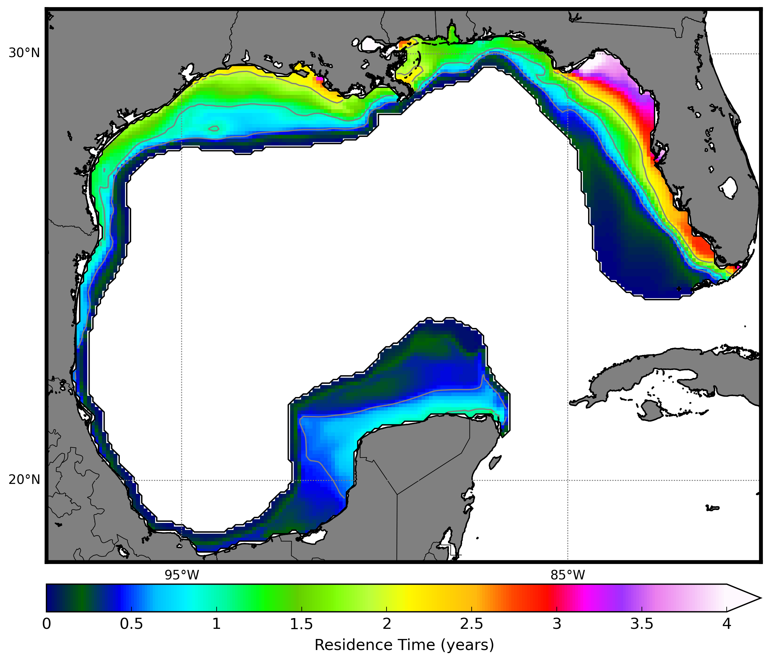
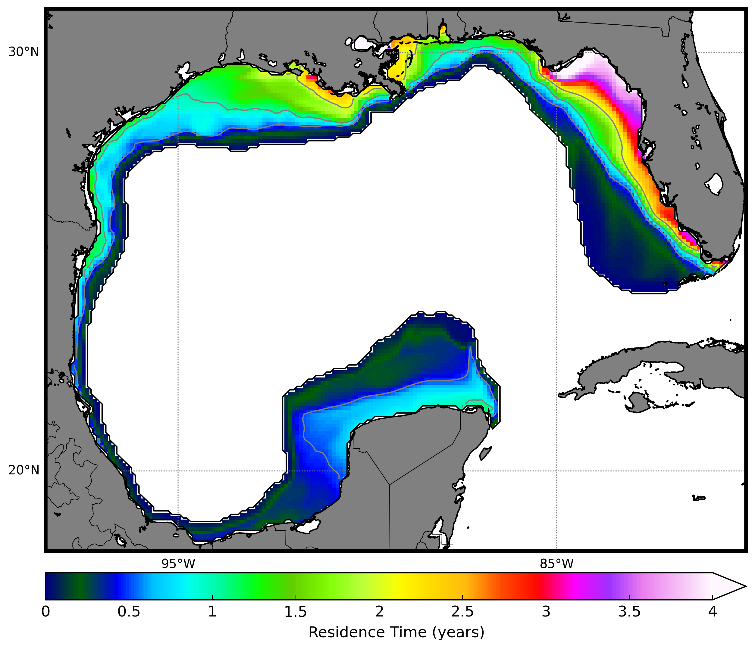
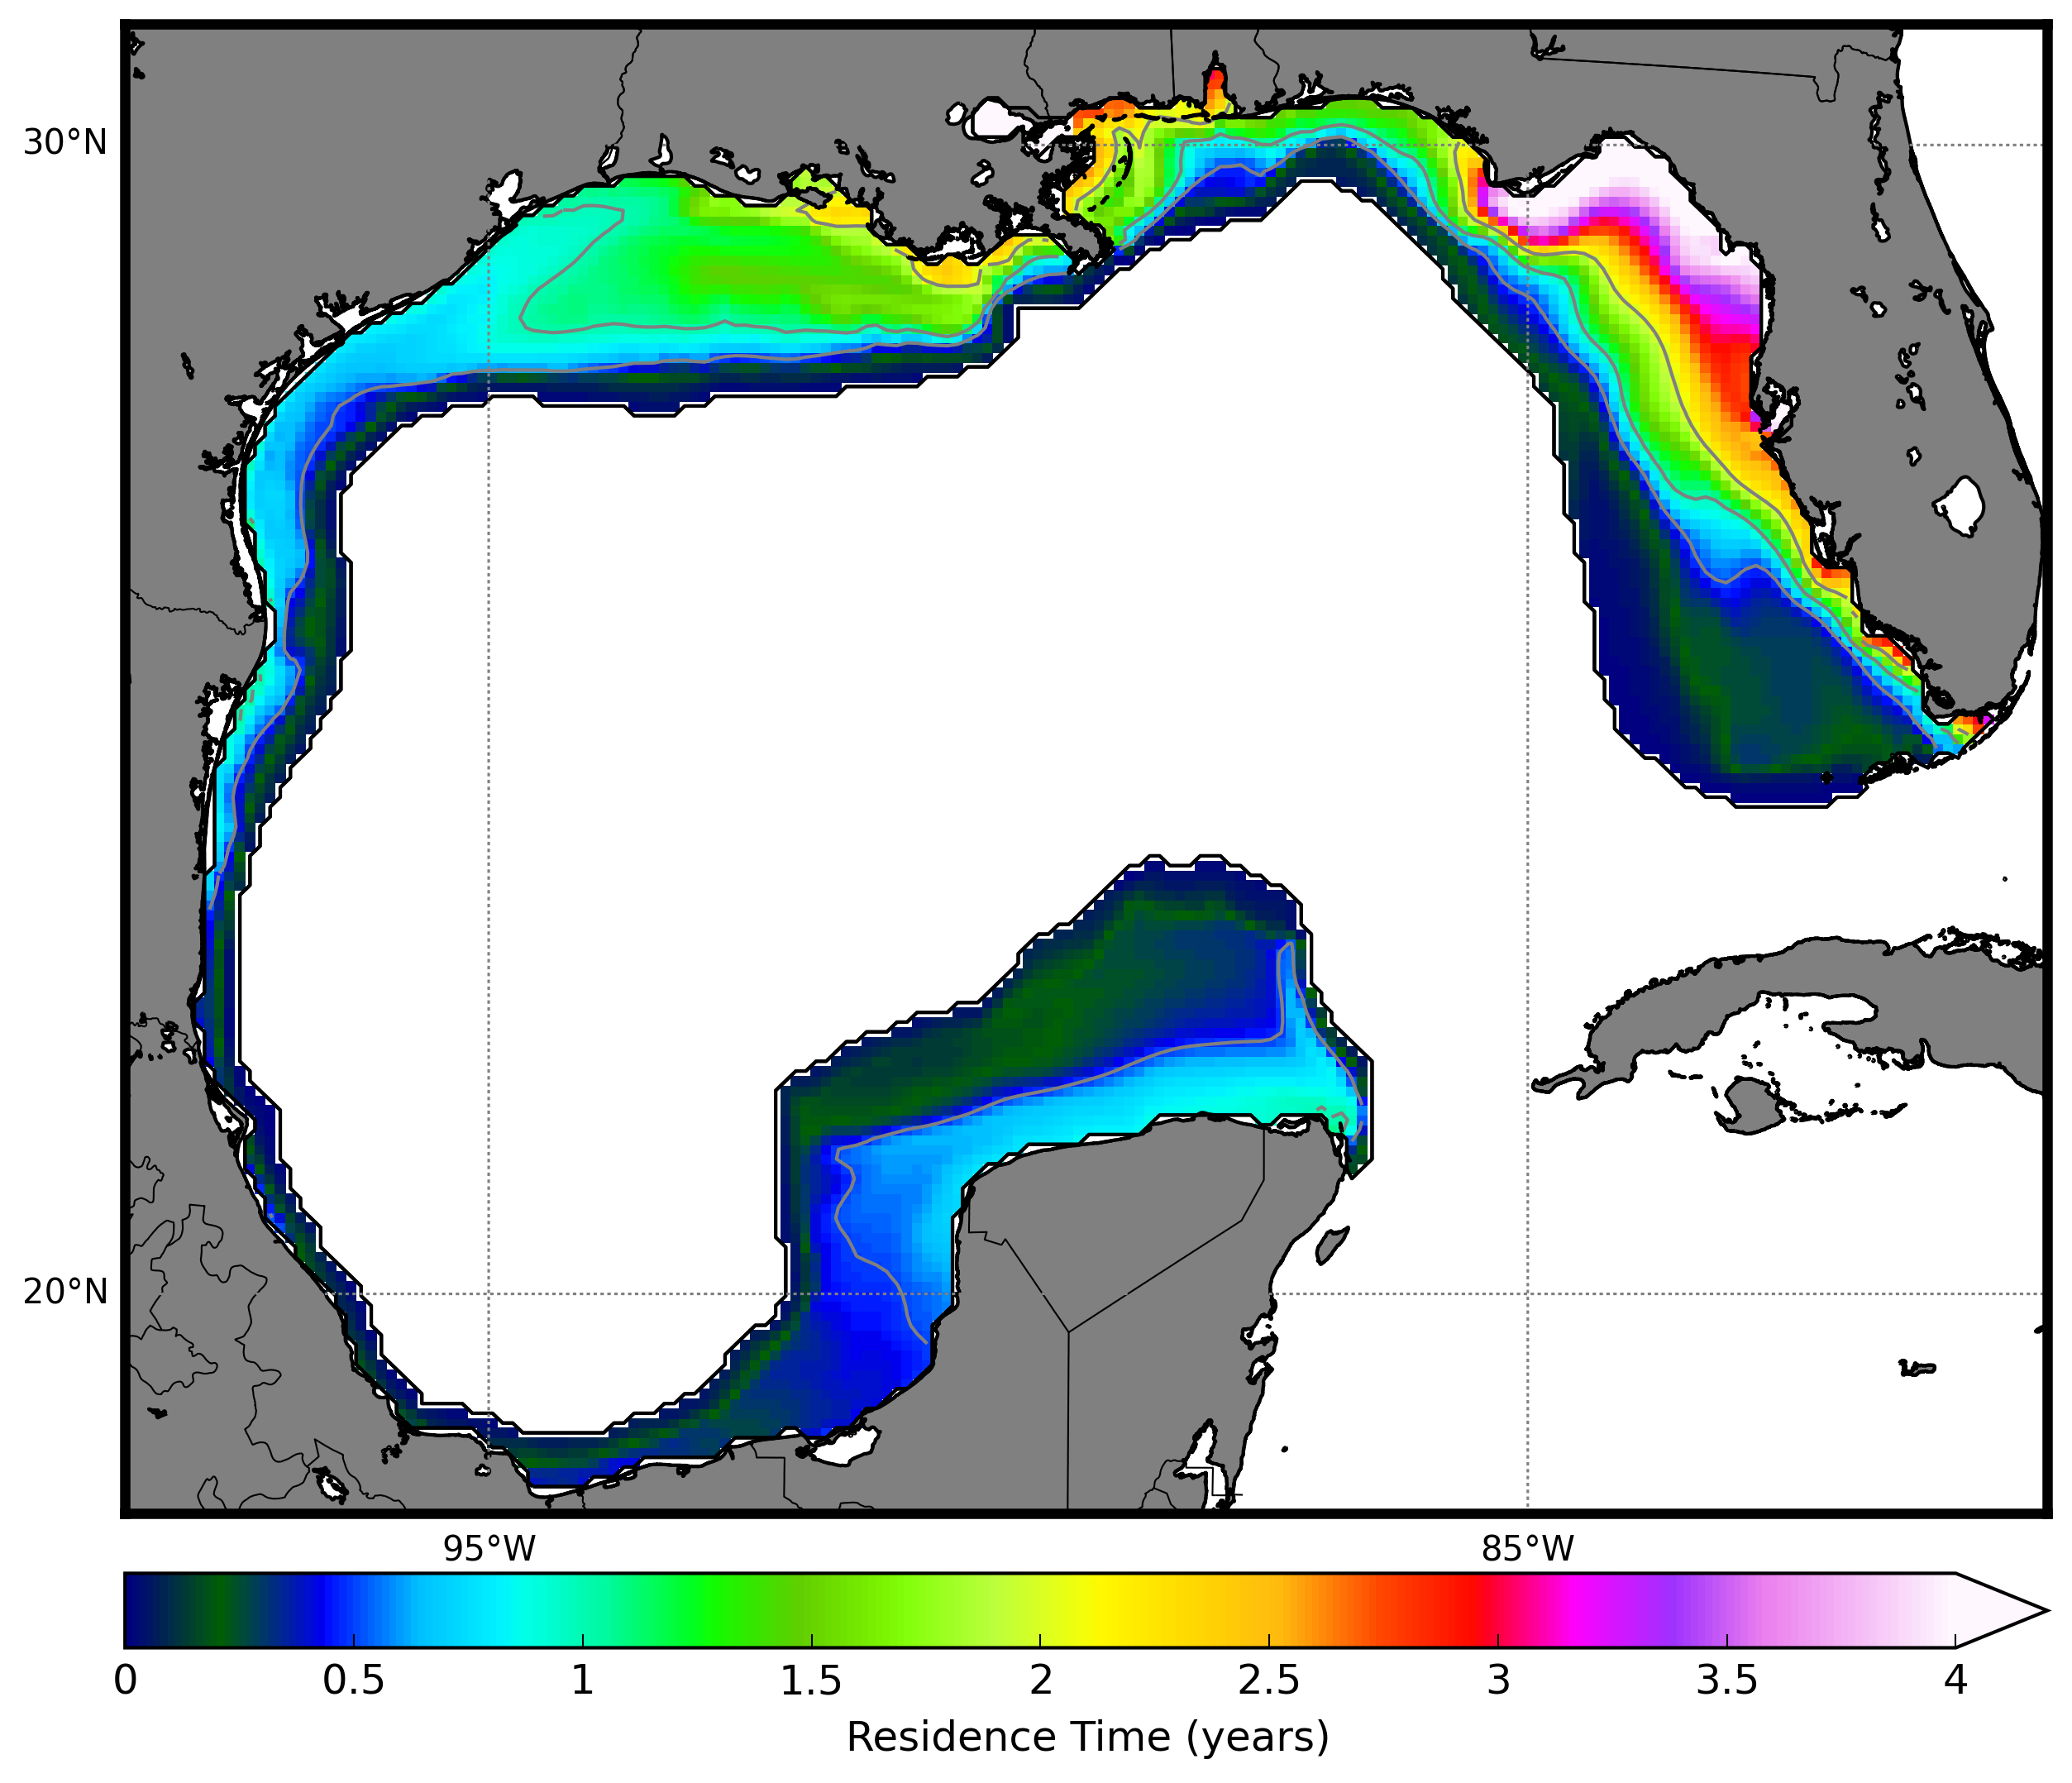

Jan
Feb
Mar
Apr
May
Jun
Jul
Aug
Sep
Oct
Nov
Dec
0
0.5
1
1.5
2
2.5
3
3.5
4
Bottom Residence Time (years)
Figure 7: Monthly mean residence time of bottom waters within the Gulf of Mexico shelf domain. Gray contours 1, 1.5, and 2 years.

Slide 8












Jan
Feb
Mar
Apr
May
Jun
Jul
Aug
Sep
Oct
Nov
Dec
0.5
2.5
5
7.5
10
Bottom Currents (cm/s)
Figure 8: Monthly mean bottom velocities (arrows) and current speeds (color shading) within the Gulf of Mexico shelf domain. Currents less than 0.5 cm/s have not been shaded.

Slide 9












Jan
Feb
Mar
Apr
May
Jun
Jul
Aug
Sep
Oct
Nov
Dec
0
0.5
1
1.5
2
2.5
3
3.5
4
Depth-averaged Residence Time (years)
Figure 9: Monthly mean depth-averaged residence time within the Gulf of Mexico shelf domain. Gray contours 1, 1.5, and 2 years.

Slide 10












Jan
Feb
Mar
Apr
May
Jun
Jul
Aug
Sep
Oct
Nov
Dec
0.05
10
20
30
40
50
Depth-averaged Current Speed (cm/s)
Figure 10: Monthly mean depth-averaged velocities (arrows) and current speeds (color shading). Currents less than 0.5 cm/s have not been shaded.

Slide 11












Jan
Feb
Mar
Apr
May
Jun
Jul
Aug
Sep
Oct
Nov
Dec
0.05
5
10
15
20
25
Depth-averaged Current Speed (cm/s)
Figure 11: Monthly mean depth-averaged velocities (arrows) and current speeds (color shading) within the Gulf of Mexico shelf domain. Currents less than 0.5 cm/s have not been shaded.

Slide 12

Figure 12: Monthly mean residence time of bottom water within the US East Coast shelf domain. Gray contours 1, 1.5, and 2 years.

Slide 13

Figure 13: Monthly mean bottom velocities (arrows) and current speeds (color shading) within the US East Coast shelf domain. Currents less than 0.5 cm/s have not been shaded.

Slide 14

Figure 14: Monthly mean residence time of surface water within the US East Coast shelf domain. Gray contours 1, 1.5, and 2 years.

Slide 15

Figure 15: Monthly mean surface velocities (arrows) and current speeds (color shading) within the US East Coast shelf domain. Currents less than 0.5 cm/s have not been shaded.

Slide 16

Figure 16: Monthly mean depth-averaged residence time of water within the US East Coast shelf domain. Gray contours 1, 1.5, and 2 years.

Slide 17

Figure 17: Monthly mean depth-averaged velocities (arrows) and current speeds (color shading) within the US East Coast shelf domain. Currents less than 0.5 cm/s have not been shaded.

